Slide 1
Pulmonary rehab
Getting back to the business of living

Slide 2
On the edge of trust
Goal: To build a pulmonary rehabilitation program that supports staff in providing the best opportunity to help people with pulmonary deficits to live confidently again,…for the rest of their lives.
01
Goal: To create an atmosphere and process that offers a defined plan with clear direction for staff and patients participating in a 6-to-8-week exercise and education program.
02
Goal: Provide people an opportunity to trust their body again and get back to the business of living.
03

Slide 3
What is Pulmonary Rehabilitation
Pulmonary rehab is……
a supervised medical program that helps people who have lung diseases live and breathe better.
beneficial for people with chronic obstructive pulmonary disease, or COPD. It has been shown to reduce symptoms of breathlessness, improve physical function and enhance overall quality of life.
Clevelandclinic.org
Msdmanuals.com
a medically supervised program that includes structured exercise training, health education, behavior modification, nutritional counseling, and the learning of breathing techniques for people who have certain chronic respiratory diseases or lung problems due to other conditions.
a program that seeks to improve the physical and psychological condition of people with chronic respiratory disease and educate these people on how to establish and maintain behaviors that will benefit their health for years to come.
Mayoclinic.org

Slide 4
OPPORTUNITY vs. ROADBLOCKS
WE HAVE A GREAT FACILITY
WE HAVE THE PATIENT POPULATION THAT NEEDS THIS SERVICE
WE HAVE THE DESIRE TO SERVE OUR COMMUNITY IN THIS WAY
LACK OF FORMAL TRAINING
INADEQUATE STAFFING
A FEELING OF UNDEFINED OR MURKY PROCESSES.
NEED FOR CLEAR VISION AND DEFINED PROCESSES.
LACK OF CONSISTENCY

Slide 5
STAKEHOLDERS AND BUY-IN
Previously “established program” so there is no pushback or roadblock from administration.
Staff – get consistent, stay consistent
Patients – buy-in, commitment, investment, acceptance, revelation.

Slide 6
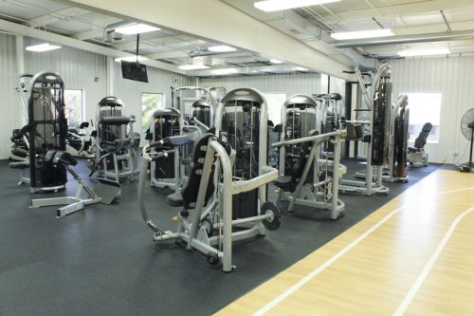
Facilities…we got ‘em!

Slide 7
Why is this so hard……?
Doubt increases with inaction
Clarity reveals itself in momentum
Growth comes from progress………
For all these reasons, BEGIN!!
To Quote the famous song by the Beatles…HELP, I NEED SOMEBODY AND NOT JUST ANYBODY!

Slide 8
OUTCOMES TO DATE.
REACHING OUT
University of Iowa Hospital Pulmonary Rehab Program.
Training new staff
Reorganizing Paperwork process
Establishing consistent baseline exercise prescription.

Slide 9
Conclusions…… and……… Next Steps
Conclusions:
Creating an established step by step process removes inconsistency and doubt.
Both the staff and patients have benefitted from the improved processes.
Paperwork is completed in a timely and efficient manor which resolves compliance issues.
It is true that clarity does reveal itself in momentum.
Next Steps:
Creating detailed “cheat sheet” with information regarding energy exertion levels on each piece of equipment.
Creating an information folder for new patients.
Continuing to train new staff.
Add additional staffing as the program grows.
Creating a legacy of teamwork and vision that can be carried into the future.

