Slide 1
We have a Teaching Kitchen! Now what?
Kara Andrew
ICAHN Fellowship Project 2023

Slide 2
Why Built?
Knowledge does NOT equal behavior change
How can we, as providers, bridge that gap?
Patients and employees
Increase source of revenue
Ancillary service
Offset community endeavors

Slide 3
Nutrition Education: What To Eat?

Slide 4
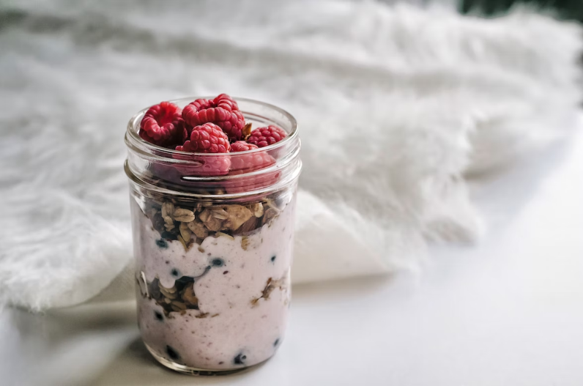
Culinary Instruction: How To Eat It
Basic cooking skills-”Bursts of Learning”
Microwave
Slow cooker
Mason jars
Build a bowl
In-depth
Stock healthy pantry
Knife skills
Fermentation
Herbs and Spices

Slide 5
Core Statement
My department is developing a patient experience presentation using our teaching kitchen to help increase utilization by piloting the experience with providers and leadership to create buy-in and increase referrals.
Goals
Increase referrals (3 month prior, 3 month post)
Assist providers and leadership on the journey to optimal health
Promote and create “buy in” for our services
Increase employee retention through department engagement

Slide 6
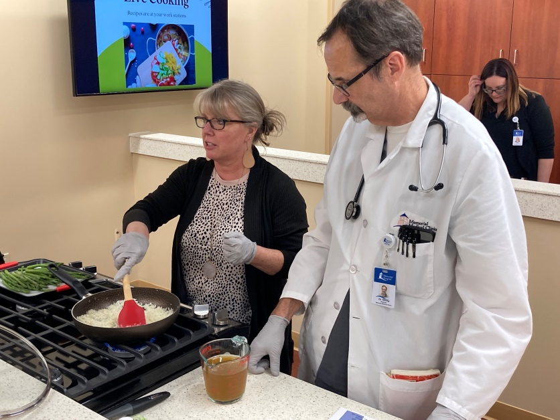
The Solution?
Scheduled presentations
Who?
Leadership, Providers
Where?
Teaching Kitchen
When?
One hour long: after work, over lunch
What?
Part One: PowerPoint
Explanation—not cooking classes!
Evidence to support effectiveness

Slide 7
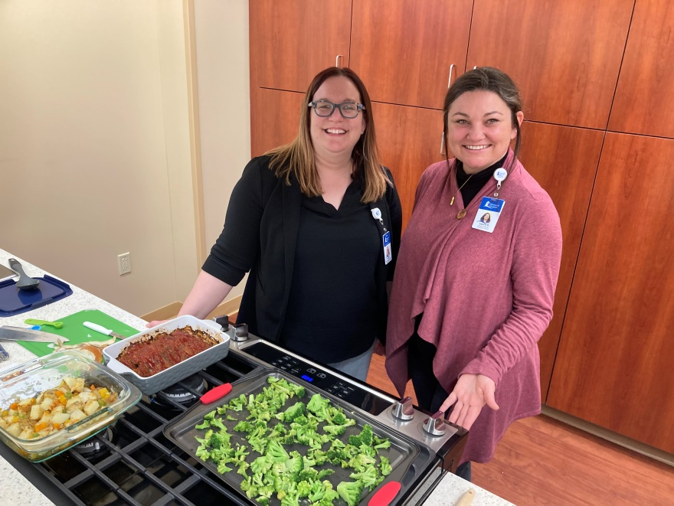
Part Two
Patient experience--SIMPLE
Provided basic nutrition information
Food safety
Dietary Guidelines
Budgeting with cost breakdown ($1.72 per person!)
Purchase all from Dollar General/Walmart
Prepared simple recipes
Socialized and ATE

Slide 8
Measurables
Pre and post survey
Post asked for feedback
Referral tracking

Slide 9
What have we learned?
Closer relationships with providers
Improved communication (inpatient)
Practice using TK
Completed 4 cohorts
Many revisions both for PowerPoint and recipes
Constructive feedback
Ideas moving forward
Employee engagement
Legalities-Waiver, Knives
SCHEDULING --
COMMITMENT
Free does not equal effective
Software
Cost, must work for all facilities in department
Reimbursement
Insurance
Cash pay
TIME
Successes
Barriers

Slide 10
Conclusions and Next Steps
Research and purchase software
Self scheduling and payment
Develop a schedule
Patients
Employees
Collaborate with Chef Amber
Chef and a Dietitian
Expand to virtual services
Subscription model
Limitless

Slide 11
Gratitude and thanks…
ICAHN especially Kathy Fauble and Liz Swanson for working so diligently to create a worthwhile endeavor
Grateful for the opportunity to grow and serve more effectively
Ada Bair for setting the example about how to be an innovative and effective leader
And for the book club!
Bob Sellers for serving as a mentor
My team at Memorial—Ashlyn Housewright and Brad Culpepper

Slide 12
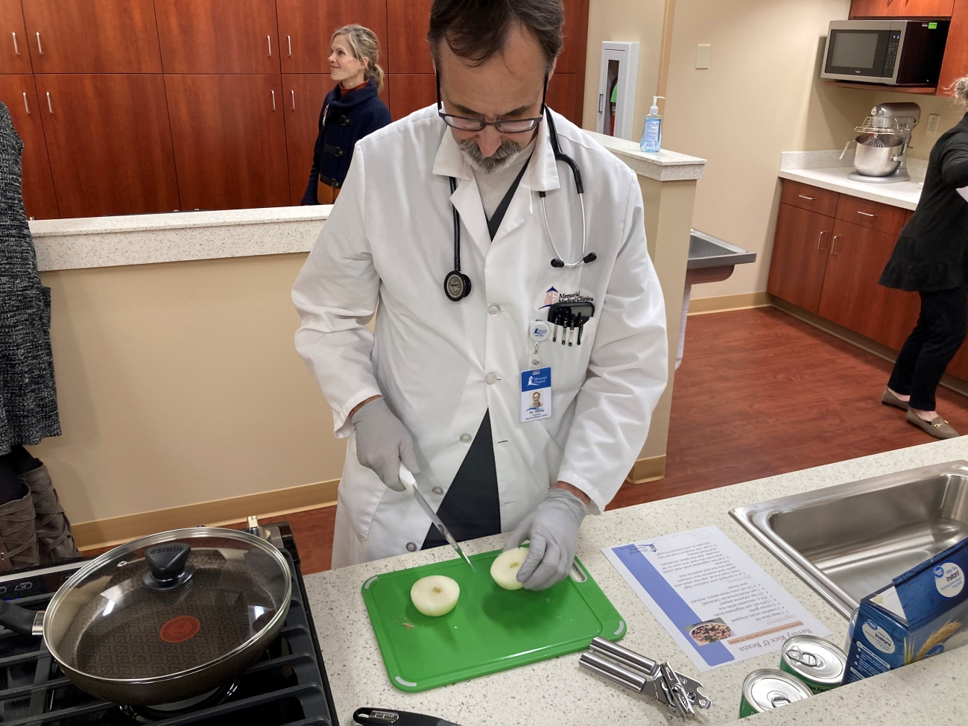
Questions?

