Slide 1
GMG FREE STANDING CONVENIENT CARE 2023 ICAHN RURAL HEALTH FELLOWSHIP PROJECT Chastity Swope|Graham Health System

Slide 2
PROJECT CORE STATEMENT
For this project, I am developing timelines, coordinating schedules and defining processes to move our Convenient Care Clinic from its current location to a newly renovated building.
This project will benefit our community and those we serve as the new free standing Convenient Care Clinic will provide additional space to expand services for both Convenient Care and our 102,000 square foot four-story medical building that currently houses both primary and specialty care physicians and advanced practice providers.
Upon completion of this project, Graham Medical Group will have the additional space to increase the current annual volume of patients in our Canton Clinics from 87,200 visits in FY23 to 95, 212 visits in FY24. This will result in a 9.2% increase overall.

Slide 3
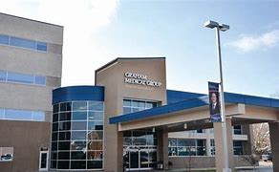
Project analysis slide 2
Project Development & Timeline Free Standing Convenient Care
FINANICAL ANALYSIS
&
APPROVAL PROCESS
SPECIFICATIONS,
NEEDS ASSESSMENT &
REGULATORY REQUIREMENTS
STAFFING/WORKFLOW WITH
MOVE DATE IN JULY 2023
DESIGN PHASE
FURNITURE, FIXTURES &
EQUIPMENT
PERMITS &
CONSTRUCTION

Slide 4
Project analysis slide 3
STAKEHOLDERS & BUY-IN
STAKEHOLDERS
BOARD OF
DIRECTORS
CEO, CFO &
VP CLINIC OPERATIONS
PHYSICIANS & ADVANCED PRACTICE PROVIDERS
GHS DIRECTORS
GHS EMPLOYEES
PATIENTS & VENDORS
.

Slide 5
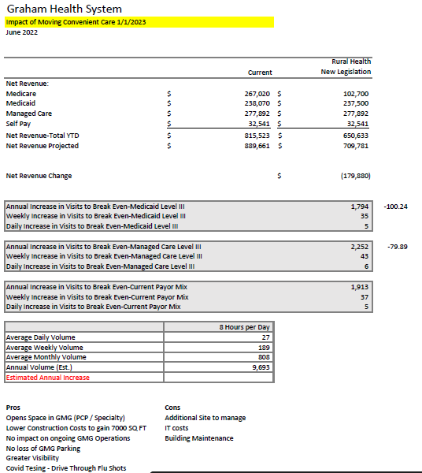
PROJECT ACTIVITY
Financial Analysis
Income Statement Estimate
Board Approval
Purchase of Building
Kick Off Meeting with P.J. Hoerr Construction
and the Architect
Design Phase Implemented

Slide 6
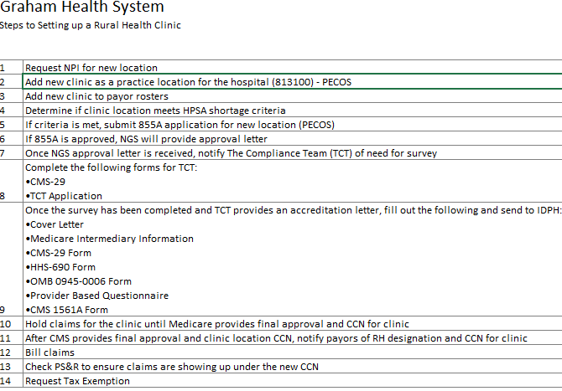
PROJECT ACTIVITY
Rural Health Checklist
Permits
Weekly Owner Meetings with P.J. Hoerr
Furniture, Fixtures & Equipment
Ongoing Meetings with Department Heads
Utilities and Contracted Services
Licensures (CLIA)
Regulatory/Emergency Management
(Joint Commission/Rural Health)

Slide 7
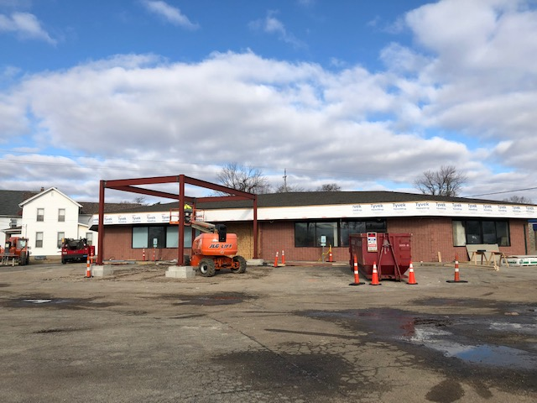
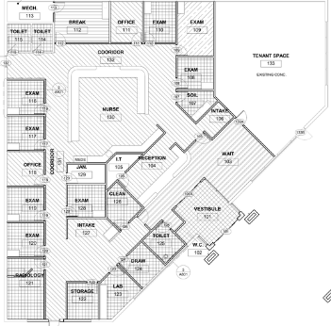
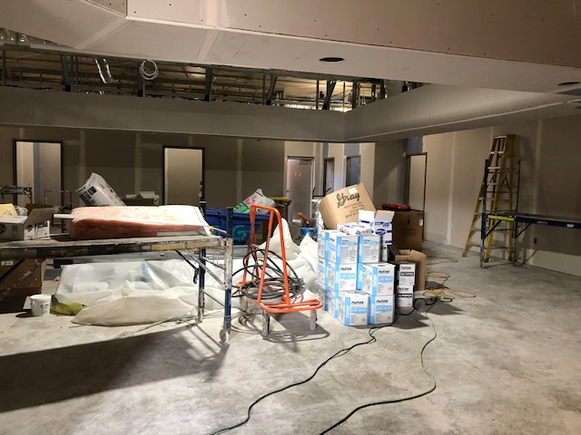
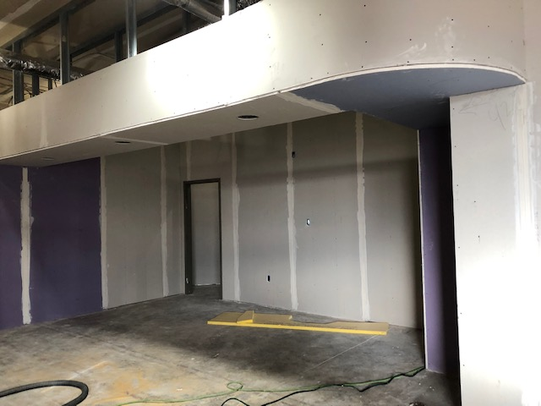
PROJECT ACTIVITY CONSTRUCTION

Slide 8
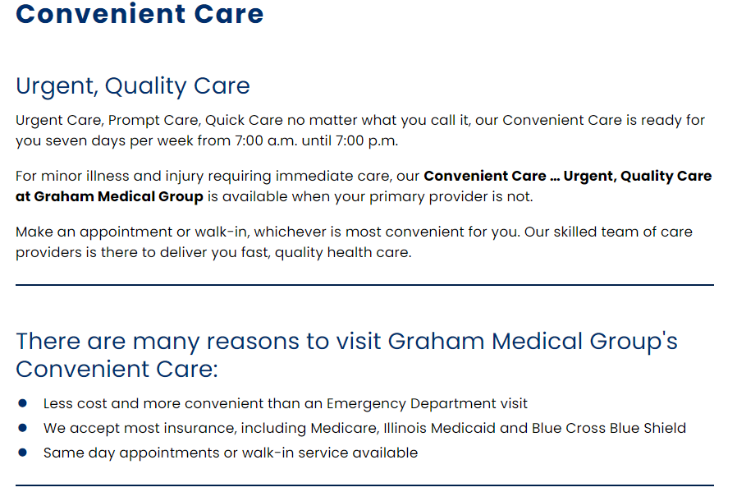
PROJECT ACTIVITY
Signage
Advertisement
Staffing
Workflow

Slide 9
Project analysis slide 8
PROJECT ACTIVITY
Barriers
Unexpected roof repair
Redesign parking lot
Delay in shipment for main exterior door
Staffing
Multiple projects
Next Steps
Handover from P.J. Hoerr to GMG upon completion of construction
Complete deep cleans
Coordinate move date
Train new hires & prepare current staff for transition
Final Move
Increase patient volume from 132,480 visits in FY23 to 165,780 in FY24 resulting in a growth rate of 25.1%.

Slide 10
Canton
Canton FS Convenient Care (Opening July 2023)
Elmwood
Farmington
Galesburg (Opening May 2023)
Galesburg FS Convenient Care
Galesburg Medical Complex (Opening July 2024)
Lewistown
Macomb (Opening June 2023)
Williamsfield
“Commitment to provide quality care for all with our ever-growing patient base” ~Bob Senneff, CEO

Slide 11
TO PROVIDE COMPASSIONATE, QUALITY HEALTH SERVICES, IN A RESPONSIBLE AND CHARITABLE MANNER, TO THE PEOPLE AND COMMUNITIES WE SERVE.

Slide 12
Thank You

