Slide 1
ICAHN Fellowship Project 2023
Adam Elder, MS, CRHCP
Executive Director of Accountability

Slide 2
Core Statement
I am developing a comprehensive plan for a 10% reduction in Medicare spending for GAH’s top 50 Medicare spend patients in order to assist our ACO in achieving Shared Savings.

Slide 3
Definitions
Medicare Attribution List
CMS patients that belong to GAH in the eyes of Medicare
ACO: Accountable Care Organization
Group of healthcare industries that voluntarily work together to give coordinated high-quality care to their Medicare patients.
IL Rural Community Care Organization (IRCCO)
Medicare Shared Savings Program (MSSP)
If IRCCO meets CMS shared savings goals, we will be reimbursed a portion of the savings.

Slide 4
Medicare Stats
GAH’s Current CMS Attribution List: 2683 patients
2% (50 patients) account for 22% of the total Medicare spend.
$27 million/yr in GAH Medicare spend
50 patients account for $6 million/yr of Medicare Spend

Slide 5
Goal Reduce overall spend of top 50 Medicare Patients by 10% in one year.
Why is this important?
MSSP
Higher quality of care for patients
Top 50 CMS spend patients explained
Too much variation in following actual patients therefore we focused on the top 50 even if they were different patients.
Started Fall 2022. Comparison date Fall 2023 stats

Slide 6
How we plan to make it happen
CCM Services: Chronic Care Management
AWV: Annual Wellness Visit
PCP office speaking with patients w/in 48 hr of ED visit
Non-Emergent Medical Transportation (NEMT)

Slide 7
Top CMS Spend Initial Stats
Annual Wellness Visit
Only 10% (5/50) of these beneficiaries were up-to-date on their AWV.
Chronic Care Management
4% (2/50) were signed up for CCM
ED Follow Up:
22% (11/50) had been seen in the ED within the last 3 mo.
Of those patients, 36% (4/11) had been followed up with from the PCP office.
100% of the 7 that fell out went to an ED other than GAH
Non-Emergent Medical Transportation (NEMT)
10% (5/50) utilize the NEMT Service on initial stats

Slide 8
CCM Services Results
Better communication with Providers and Clinics
Monthly reports to each clinic
Added to Provider Dashboard which is seen by Hospital Board
Revamped marketing materials
146 enrolled in CCM in Nov 2022
213 in March 2023
46% increase in 4 months
20% of top 50 now enrolled in CCM

Slide 9
Annual Wellness Visits Results
Increased communication w/ Providers and Clinics
Monthly Reports for each Clinic
Added to Provider Dashboard which is seen by Hospital Board
FY23 Q1 300 AWVs
FY23 Q2: 358
19% increase in Q2
4% (down 6%) of the top 50 spend patients were up-to-date on AWV

Slide 10
PCP follow Up w/in 48 hrs of ED Visit
FY23 Q1 93% in overall ED callbacks 1052/1140
FY23 Q2 89% in overall ED callbacks 1044/1171
Decrease in 4%
Explanation for decrease:
Largest Clinic had some staffing turnover
We started to include outside ED numbers
Better questions we need to address: Why we have 1100 pts a quarter turning to the ED for care?

Slide 11
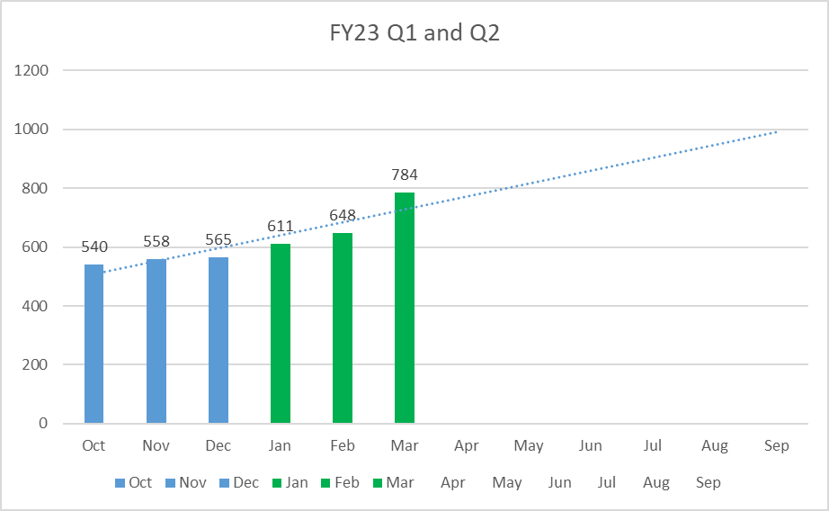
Non-Emergent Transportation
Added a NEMT Driver and vehicle in Nov 2022
Rides increased 23% in Q2
16% of the top 50 CMS Spend patients now utilize NEMT

Slide 12
Results Recap
CMS spend data: too early to use this as a gauge
CCM
Increased total CCM by 46%
Increased top 50 from 4% to 20%
AWV
Increase overall AWV
Decrease of top 50
ED Callback
Added in outside ED visits but 4% decrease in compliance.
Currently 89% success rate
NEMT
Increase in rides but did not have as much impact on top 50.

Slide 13
Lessons Learned
The top 50 tend to be mostly “non-actionable” (hard to decrease costs)
Cancer Treatments
Dialysis
Need to expand our focus to top 100 highest spend.
Top 100: 34% of Medicare Spend 0r $9 million
CCM: We did not see the expected increase from Nov 2022 to March 2023
CCM fairly new for the providers and clinics
Stronger focus on the next 50 highest.

Slide 14
Lessons Learned continued
Although AWV rates in general increased, we need to do a better job of targeting the high spend list.
Will likely increase when we focus on top 100.
NEMT Service has made tremendous impact on overall patient population having access to services but negligible effect on high spend patients.

Slide 15
Thank you
ICAHN Rural Health Fellowship
Kathy Fauble: ICAHN Professional Education Service Director
ICAHN Mentor:
Andrew Kleinschmidt: VP Professional Services at Wabash General Hospital
GAH Team:
Maille Francis, ACO Specialist
Rachel Espinoza, NEMT Dispatcher
All of the providers, nurses, and clinic managers.
Administrative Team

