Slide 1
2022-2023 Rural Health Fellowship Project: Dreams
Sheridan M. Voshake, MS, MLS (ASCP)^{cm}
Medical Laboratory Supervisor
Memorial Hospital, Carthage, IL

Slide 2
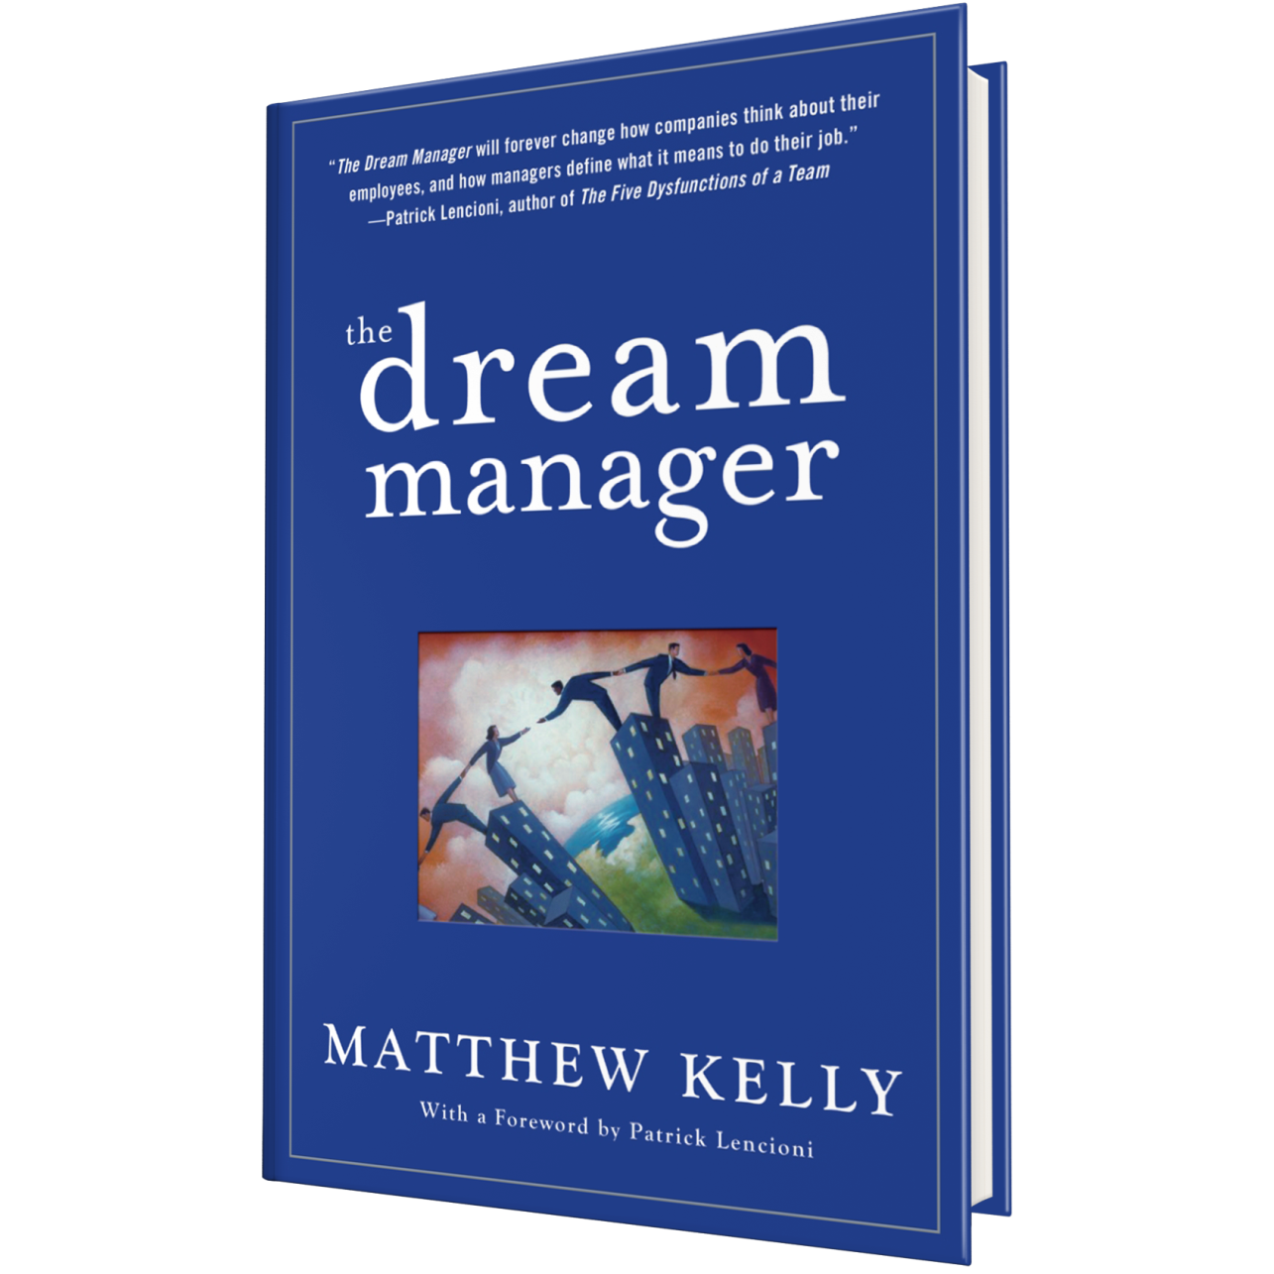

Slide 3
Overview & Purpose
The Laboratory Department of Memorial Hospital in Carthage, Illinois is developing a Dream Facilitation Program to help promote a caring culture that supports employee engagement and team building by encouraging Laboratory employees to identify and achieve their dreams.

Slide 4
Objectives & Timeline
Encourage engagement
Increase job satisfaction
Build trust
Raise group morale
Reduce turnover
Collect dream survey
Facilitate dream achievement
Follow-up on progress
Analyze results
Hold individual meetings

Slide 5
Stakeholders & Buy-in
Lab Department
Clinical Lab Staff
12 Techs
Leaders/
Supportive Roles
4
6 Phlebotomists
Fellowship Mentor

Slide 6
Activities
Dream Survey Question: WHAT ARE YOUR DREAMS?

Slide 7
Dream Survey Results

Slide 8
Successes & Barriers
Participation
2/3 responded
Time
Conversations
Continual
Dreams
Long-term
Realistic?
Trust, new

Slide 9
Outcomes to Date
Education
Tech (MLT) Dream:
MLS (Bachelor’s)
Phleb #2 Dream:
MLT (Associate’s)
Phleb #1 Dream:
MLT (Associate’s)

Slide 10
Next Steps (Laboratory)
Dream progress check-in during quarterly rounding
Celebrate dream achievement!
& continue…
Identify new dreams annually

Slide 11
Next Steps (Organization)
Present project to Leadership?
Roll-out to all employees?
Leadership group to read book?

Slide 12
Reference
Acknowledgements
Kendra Taylor, DNP, RN, McKendree University
Kathy Fauble, M.Ed, ICAHN
ICAHN Fellowship Advisory Committee, Faculty, & Fellows
Memorial Hospital Carthage, IL & Laboratory Department
Kelly, Matthew. (2007). The Dream Manager. Hyperion.

Slide 13
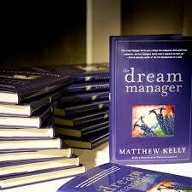
Questions?

Slide 14
What are YOUR dreams?

