Slide 1
T-minus Four Months Until Crystal Lake Hospital Opening: Onboarding and Retention of New RN Leaders
Mercyhealth Mission: “Passion for making lives better”
Presented by: Kendra Rishling MSN,RN

Slide 2
Core Statement
For this project, I am developing a comprehensive onboarding plan and program to facilitate the onboarding/orientation of new RN leaders over a four-month period specifically targeting key leadership skills to develop confident and resilient leaders who desire continuous learning and longevity with the organization.
This Photo by Unknown Author is licensed under CC BY-SA

Slide 3
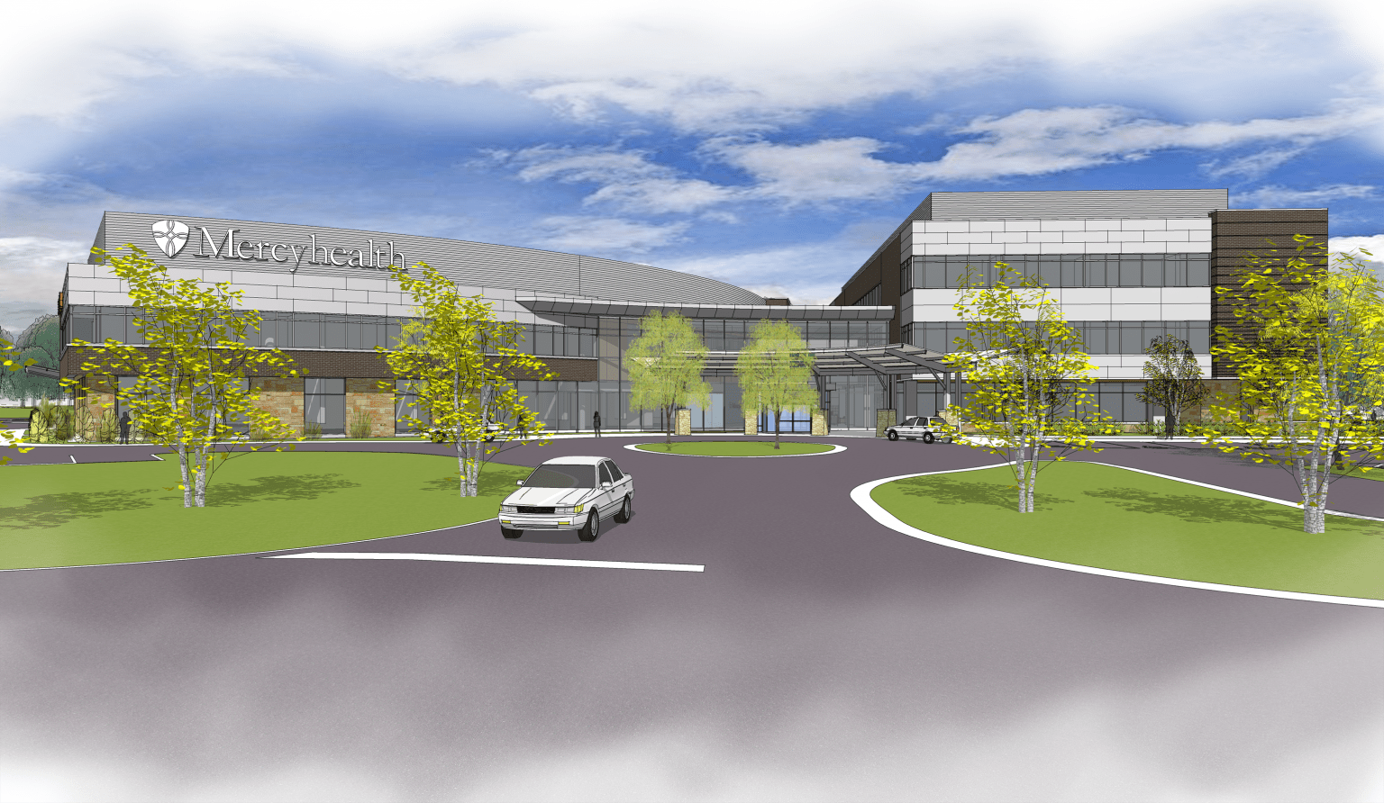
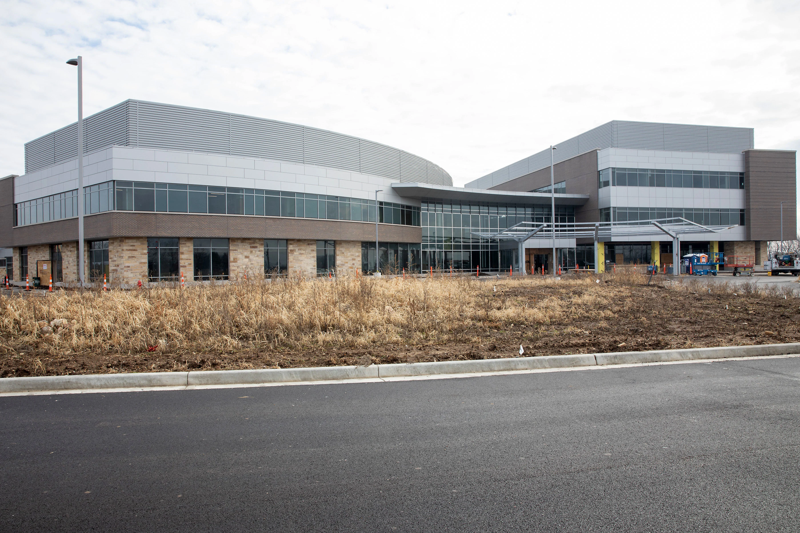
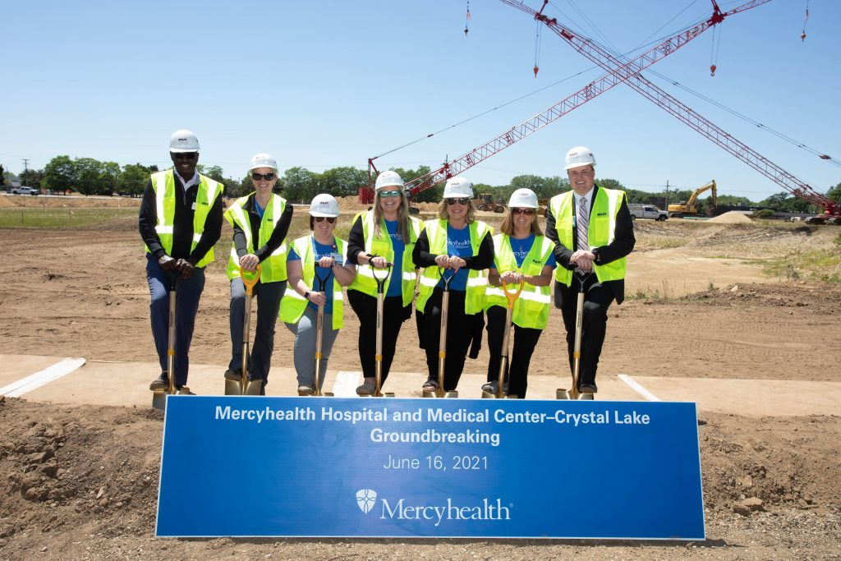
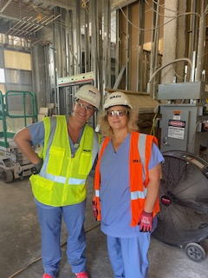
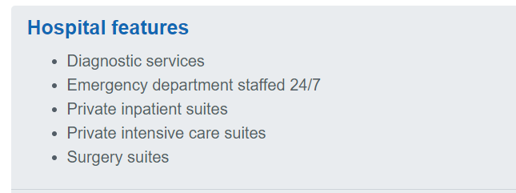
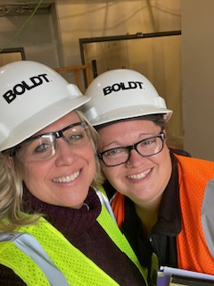
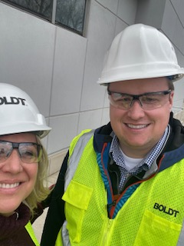
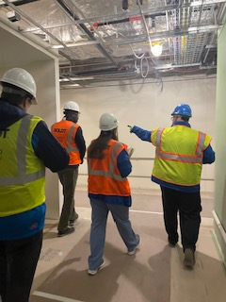
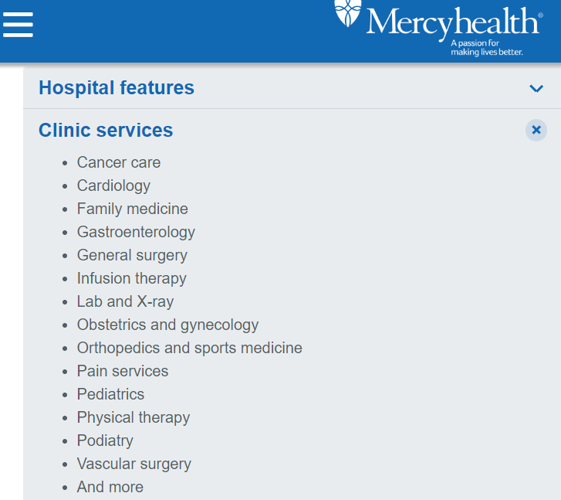
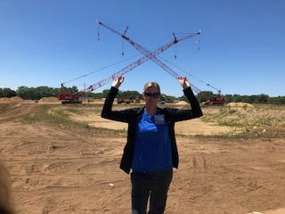
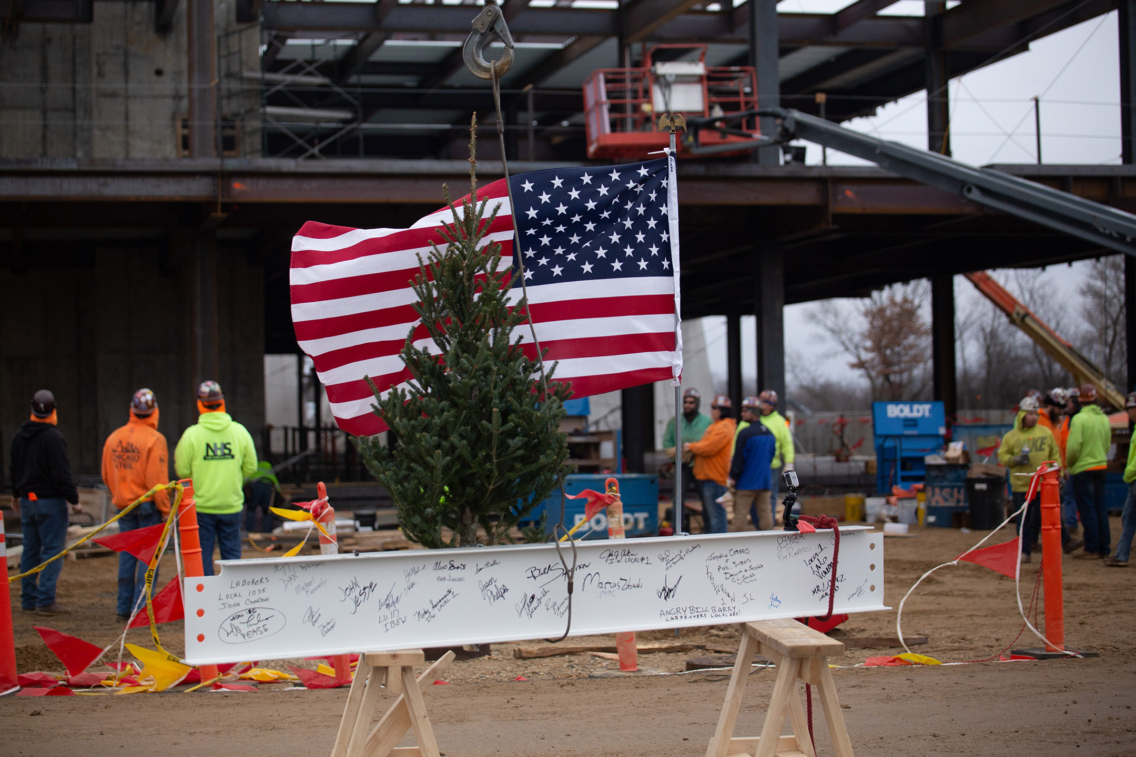
Background

Slide 4
Project Benefits, Purpose, and Objectives
This project will benefit new RN leaders and their teams by focusing on leader development and achievement of the needed skills to confidently lead high performing units in just a short timeframe of four months.
This project establishes a clear purpose, plan, and timeline for the new RN leader to successfully onboard in four months and achieve desired strategic initiative related goals.
Objectives include: the development of an onboarding plan along with implementation of educational workshops and programs that support professional development and growth of new RN leaders. Creation and use of specific resources, tools, and deliverables will support the new RN leaders in operationalizing and preparing their care teams for a smooth and successful new hospital opening in four months.
This Photo by Unknown Author is licensed under CC BY-NC-ND

Slide 5
Tasks/Activities
Create Onboarding Comprehensive Plan
Create RN Leadership Education Development Plan
Develop Program for new RN leaders to Establish Departmental Initiatives and Goals Aligning With the Organization’s Strategic Plan
Create a Team Alignment Program and Plan
Develop Team Building Program
Ongoing Professional Growth and Development Program
Aspiring Executive and CNO Leadership Program
Notes:
Onboarding Plan-Outline of the Onboarding process for new RN leaders. This was reviewed by the Professional Development team. This plan included a project timeline of deliverables along with the expected completion date. Approval to move forward in March 2023.
RN Leadership Education Development Plan- The purpose of this plan is to ensure that the RN Leaders are equipped with the necessary tools and resources to be confident, accountable, fiscally responsible, and emotionally intelligent leaders who support and lead teams in accordance with the organization mission, vision, and values.
Develop Program to Establish Departmental Initiatives and Goals-The purpose of this is to develop and establish initiatives and goals that the new RN leaders and their teams can work on together to promote quality, elevate the patient experience, and establish departmental goals that align with the organization’s Strategic Plan.
Team Alignment Program and Plan-The purpose is to support RN Team Leaders in building highly effective teams that support mission accomplishment. The program will assist leaders in managing barriers to performance and goal achievement. This program will include partnering with organizational and service line leaders to assist in building a high-performing team.
Team Building Program-
Ongoing Professional Growth and Development Program workshops
Aspiring Executive and CNO Leadership Program- a succession planning initiative to improve long term retention of highly engaged and high performing leaders who aspire to reach executive level leadership. RNs that apply will have to meet set criteria and then be accepted into the program by the Directors,CNOs or VP level leaders in a once a year offering of an 8 week orientation to Executive and CNO leadership experience.

Slide 6
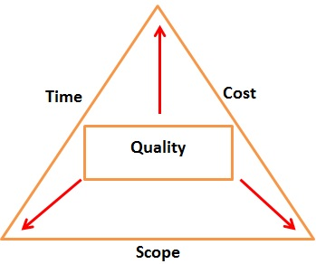
Deliverables
A comprehensive onboarding plan.
Excel sheet outlining all plan deliverables
Content and materials for RN Leadership Education Development 1-2 hour workshops for three-day education event
Document containing organizationally aligned coaching criteria and process for executive leadership coaching
Mentorship program guide updated with mentor and mentee interaction suggestions and feedback tools for biweekly check ins
Reality-Based Leadership school and tools
Tipsheet for increasing emotional intelligence
Crucial conversations: reframing questions tip sheet
Upskill Workshops for existing managers and executive leaders
Monthly Dashboard reports for department goals, Performance Improvement tracking, quality strategic initiatives dashboard
Community event and team building opportunity calendar
New leader weekly evaluation tool: activities/next week action items
Leadership Links Assignments for peer discussion
This Photo by Unknown Author is licensed under CC BY
Notes:
Onboarding Comprehensive Plan outlines the plan timeline(stakes in the ground), deliverables, and expected outcomes to successfully onboard new RN leaders in four months time. All these items will be identified and tracked on an excel spreadsheet and shared with all the stakeholders. Biweekly updates to achievements will be reported to executive leadership along with feedback tool to address any need for enhancements to the plan or any changes in the scope, cost, quality or timeline.

Slide 7
Timeline
Four months to complete successful onboarding and orientation of the new RN Leaders
Crystal Lake Hospital opens Late July/Early August 2023
April
Getting Real!
May
Real!
June
Hospital Opens
July 24, 2023
It’s going to be great!!!!
It is great!!!!
New RN Leaders and Hospital
EST. 2023

Slide 8
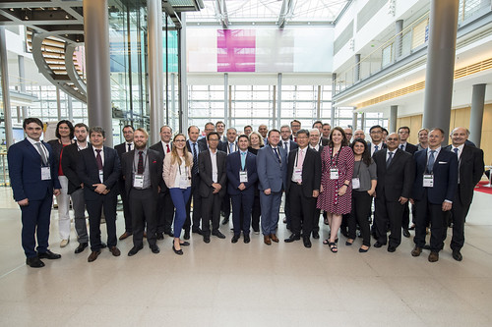
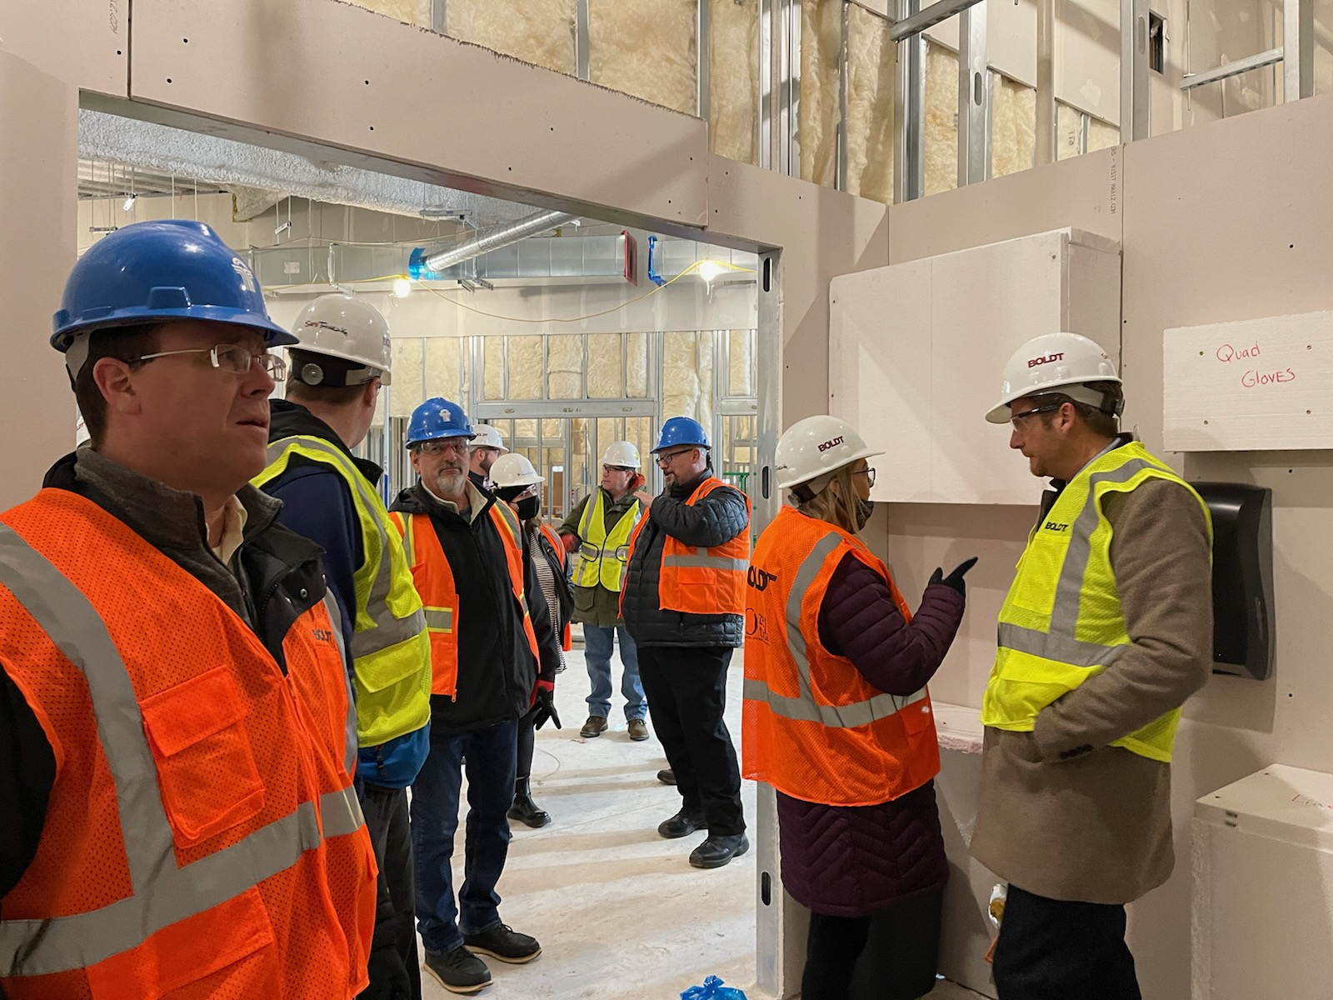
Stakeholders and Buy-In
New RN Leaders
Patients
Executive VPS
RN Educators
Nurse Managers
CNOs
Human Resources and Program Development Department
Contractors for the Build
Facilities
Biomedical
Finance
RN unit teams
Physicians
This Photo by Unknown Author is licensed under CC BY-NC-ND
Notes:
As the project manager, developing relationships with key executive stakeholders and involving the early on ensures a successful rollout along with expertise influence in the design, support, and sustainability of the new RN Leader Onboard and Retention plans. Establishing Key stakeholder engagement by identifying program champions will create a smooth rollout of the project. Together with RN Leadership, Educators, and HR the program will provide a multifaceted approach to quickly onboarding and preparing nurse leaders to successfully lead unit teams, projects, and meet system initiatives that support strategic initiatives and align with the mission, vision, and values. These champions also engage their peers to provide support and expertise with creating best practice standards and deliverables. Stakeholder buy in is the momentum and fuel behind any successful project.

Slide 9
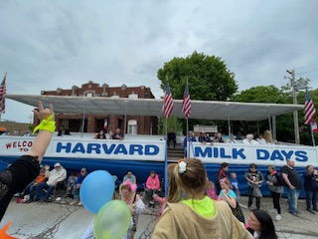
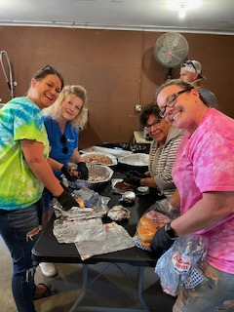
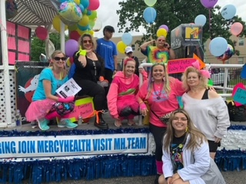
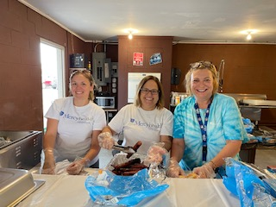
-Team Building Activities -Continuous Learning Opportunities -Supporting Professional Growth -Provide Merit Credits and Succession Opportunities = Successful Onboarding, Orientation and Retention of New RN Leaders!!!!!
Retention Strategies
Notes:
Investing in your team: team building exercises, volunteerism in the communities, participation in external organizations, partner appreciation and recognition programs, continuous learning

Slide 10
Success/Outcomes to Date
Successfully Completed New RN Leader Onboarding Comprehensive Plan and Implemented
Education Plan for Professional and Leadership Development Established and 1-2 hour workshops have commenced
Mentor Program updated and in use along with the feedback/action forms
Executive Coaching Criteria developed, and Tip sheet in use
Continuing Education for Leaders Upskill workshops schedule created and open for sign ups
New RN Leaders are doing well and staying on the timeline
Hospital is still on time to open July 24th, 2023

Slide 11
Barriers
Construction Delays and Survey Application Timelines
Staffing and Hiring Shortages
Orientation of New Hires (leaders and direct care nurses)
New Leaders trying to do their “regular job” and manage CL hospital project
Delay in approval and posting for leader positions
Financial Constraints

Slide 12
Next Steps
Training, Onboarding ,Orientations, Occupancy
Marketing Efforts for social media to support job fairs
Submission of survey applications
Review Applications
Complete the Team Building Program

Slide 13
Questions?

