Slide 1
Hospital Based Home Health Agency
APRIL NETTLETON
ICAHN FELLOWSHIP 2022-2023

Slide 2
THE JOURNEY
The First Project
The Panic
The Resolution

Slide 3
THE GOAL
To develop a hospital based home health agency to help discharged patients in the Gibson Area Hospital service area with home care by setting up different scopes of practice such as RN administered IV meds or wound care, Home Aides for activities of daily living, physical therapy, occupational therapy, and speech therapy to allow for care in the patient’s home.

Slide 4
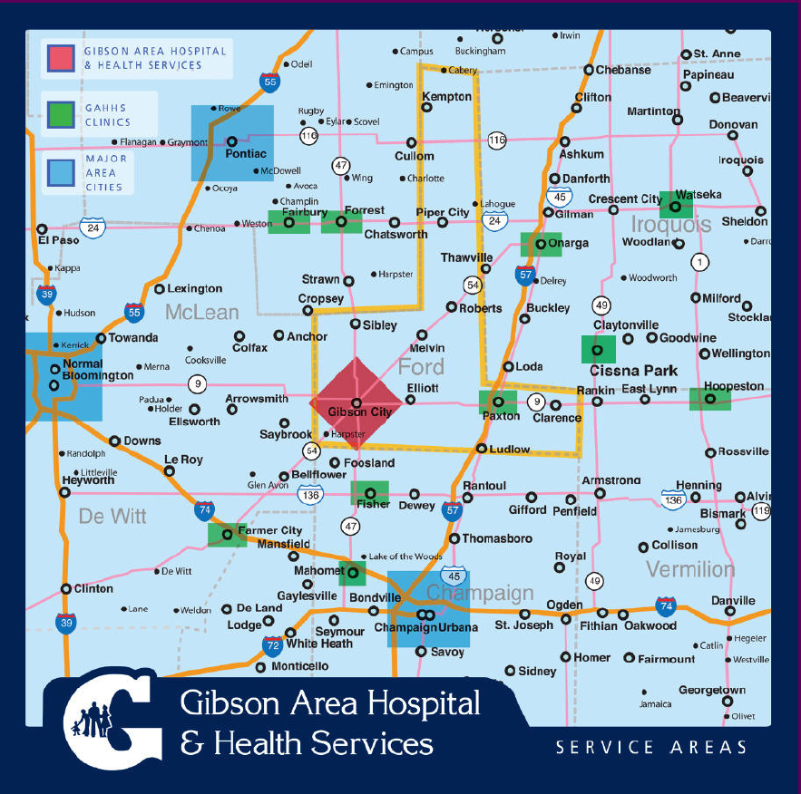

Slide 5
THE NEED
How we got here
Other Home Health agencies in the area
What is happening with our patient population
Critical Access Hospital Rules

Slide 6
SWOT ANALYSIS
Strengths
To have the capacity to discharge patients to the comfort of their home to receive the care they need
Receive the reimbursement for claims and not be denied due to patient staying too long in the hospital per CAH rules.
To have home health access for our patients so they can retain their providers
Weaknesses
Hiring enough staff
Where to locate home health agency and staff
Billing and charging for home health

Slide 7
SWOT ANALYSIS CONT.
Opportunity
The need for treatment of patients in the comfort of their own home
Paid on value
Few home health agencies in our service area
Threats
Changing regulatory environment
Keep pricing competitive to cover expenses and be profitable
Competitive free-standing agencies

Slide 8
THE PLAN
Read State Law and Federal Regulations
Meet with Administration and form a group of stakeholders
Create a business plan
Develop a budget
Register with the state
Decide what accrediting body we are going to use
Service location decision
Review reimbursement with payers
Hire staff

Slide 9
CONCLUSION
Very beginning stages
The need is there
Creating the plan and implementing the plan
Overcoming obstacles
Helping our patients receive the care they need in the comfort of their homes

Slide 10
THANK YOU and QUESTIONS

