Slide 1
Non Rural Health Dermatology Project
Jennifer Rigdon
Icahn fellowship 2021-2022

Slide 2
Develop a non rural health cosmetics department within our current rural health dermatology department
Phototherapy
Skin care line of products
Botox
Fillers
Micro needling
And beyond

Slide 3
Stakeholders
Administration
Dermatology nurse practitioners
Staff-Dermatology and Women’s health

Slide 4
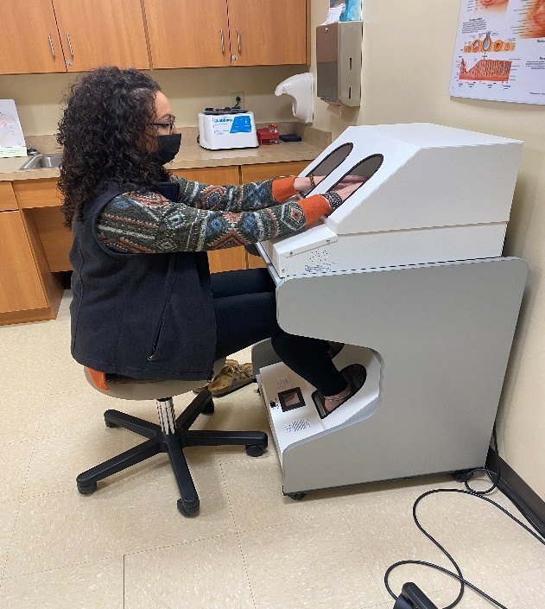
PHOTOTHERAPY Our Stand up and Hand/Foot units use ultraviolet B rays to treat a variety of skin conditions

Slide 5
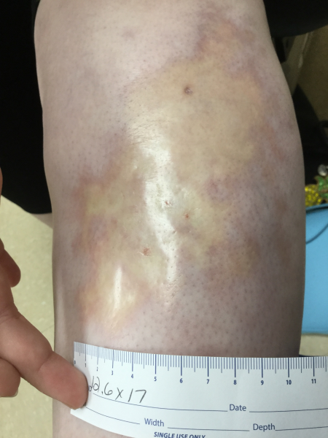
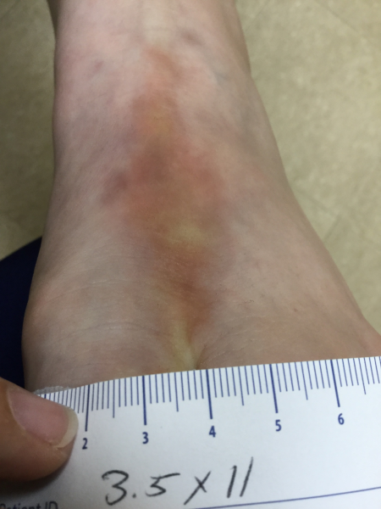
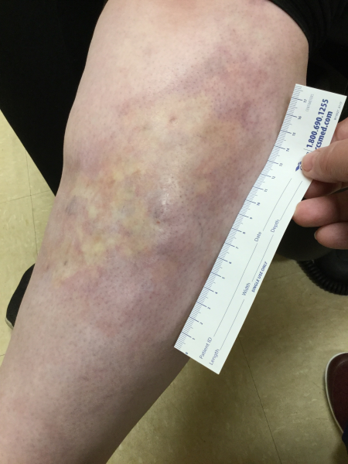
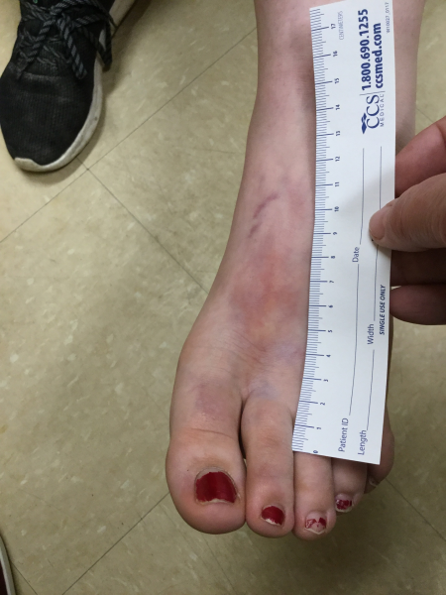
Skin conditions treated include psoriasis, atopic dermatitis/other eczemas, vitiligo, lichen planus, pruritis, morphea(shown below) and many others

Slide 6
Treatment Goals
Dermatitis conditions-Relieve itching, improve rash
Vitiligo-Repigmentation-100% is not achievable
Psoriasis-Immune system depression to slow down T-cell production, decrease plaques, itching, remission

Slide 7
Getting Started and Where Are We Going
Where should this service go?
Scheduling non rural health and rural health appointments
What items are needed– eye protection, mineral oil, towels, paper bags?, SPF 50+ and Lip Balm 30+ (oxybenzone and octinoxate free)
Staff training
Charting in our EHR

Slide 8
Epionce Skin Care Line

Slide 9
“Be good to your skin. You’ll wear it everyday for the rest of your life”
All natural line of skin care products developed by a Dermatologist
Providers choice of which skin care line they wanted to provide
Adjunct therapy to current dermatology treatments for multiple skin issues including eczema, aging, rosacea, keratosis pilaris, psoriasis

Slide 10
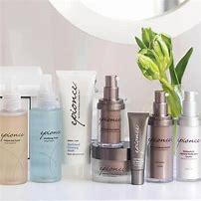
Sales and Training

Slide 11
Neurotoxin Injections

Slide 12
Providers attended training in December and were ready to get started…. Now. Instead, we agreed on March 3rd

Slide 13
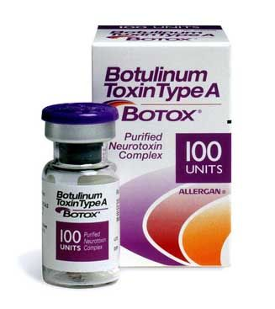
Schedules had to be built
Supplies ordered
Training for staff
Practice on employees, friends, and family starting March 3, 2022
Rolling out to the public on May 2, 2022
Currently Botox only but Xeomen and Dysport will be added

Slide 14
Conclusion and Next Steps
Chemical peels
Dermal Fillers
Micro-needling
Lasers

