Slide 1
Marshall Specialty Clinic
Lacey Stults, MBA, MSN, RN, CRHCP

Slide 2
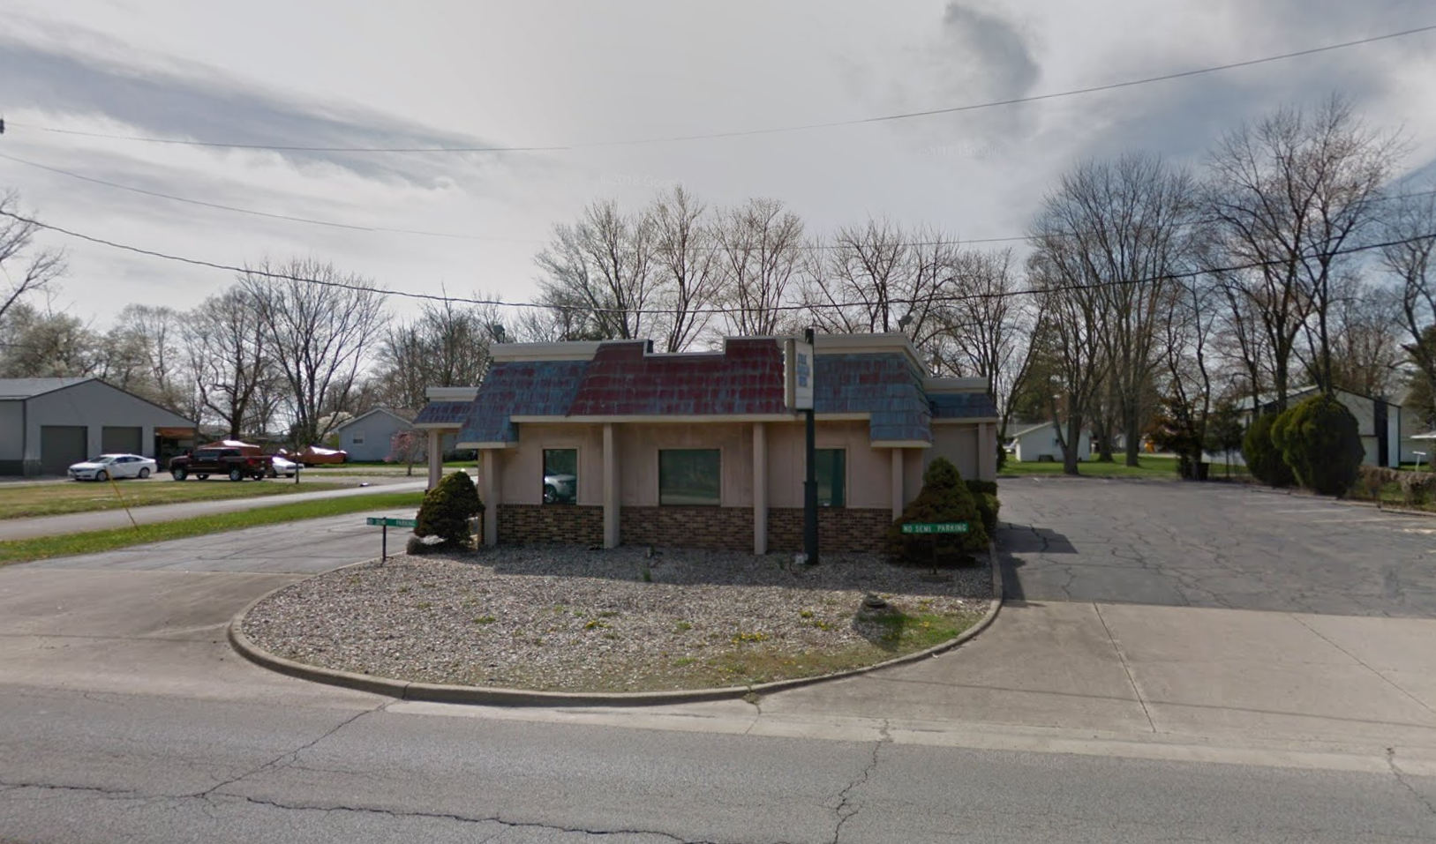
Project Overview
Goal: Open a provider based clinic in Marshall, Illinois in the Spring of 2021

Slide 3
Purpose
Increase physical space in which providers see clinic patients
Add convenience to towns outside of the Horizon Health primary county of service
Expand the patient base for pain management, orthopedics, and spinal surgery

Slide 4
Objectives
Clinic services obtained at the Marshall location – Goal May 15th
Increase procedural and surgical volume specific to orthopedics and spinal surgery
*An initial objective of dermatology has been vetted and cut from the scope of the clinic

Slide 5
Stakeholders
Patients
2 Physicians
CRNA
Credentialing consultant
Maintenance
Clinical Informatics
Referring Providers
IT/Related companies
Operational Managers
Administration
Board Members
PR/Marketing
Notes:
Commercial 44%
Medicare 32%
Medicaid MCO 21%
Self Pay 2%
Medicaid 1%

Slide 6
Activities
2020 – Exploration of clinic opportunity, signing lease, hiring of additional orthopedic/spinal surgery providers
January 2021 – Kick off meeting with maintenance, IT, and administration
February 2021 – Check point meeting with original stakeholders for decisions on major furniture needs
March 2021 – Provider needs assessed and clinical ordering begins, Clinic name established, EHR departments established and initial patient volumes estimated
April 2021 – Floor renovation, minor construction updates, internet installation, Hours of service established, contact information established, 855A filed
Notes:
Commercial 43%
Medicare 33%
Medicaid MCO 19%
Self Pay 3%
Medicaid 2%

Slide 7
Obstacles and Barriers
Timing of growth
Rural Health vs. Non-Rural Health
Water access
Delivery timelines longer than anticipated
Lack of outwardly set budget

Slide 8
Conclusions/Next Steps
Establish consistent staff for reception
Opening Day
Set date for additional service line starts
Marketing of services
Establish consistent operations such as patient survey process and policy development
Evaluate operational efficiency and return on investment for final building purchase

Slide 9
Open Discussion

