Slide 1
ICAHN Fellowship Project
Erin Frank, Horizon Health

Slide 2
Project Overview: Data
Research
Train
Understand
Report
Share
CRM
Purchase
Great things never come from comfort zones.
- Pat Schou

Slide 3
Objectives
Better understand and use data to make (marketing) decisions
Show ROI after decisions are made
Determine target market for specialists
Automate patient communication

Slide 4
Objectives—CRM Specific
Wellness campaigns to improve health outcomes
Automate annual visit reminders to improve compliance
Patient targeting to improve quality measures
Chronic care management communication to engage patients
Close gaps in care by geotargeting using social determinants of health
Improve specialist marketing by understanding competition

Slide 5
Stakeholders
Clinic Director
CFO
Providers—specialists in particular
Chronic Care Management Team
Systems Manager/Information Services
My team
Board of Directors

Slide 6
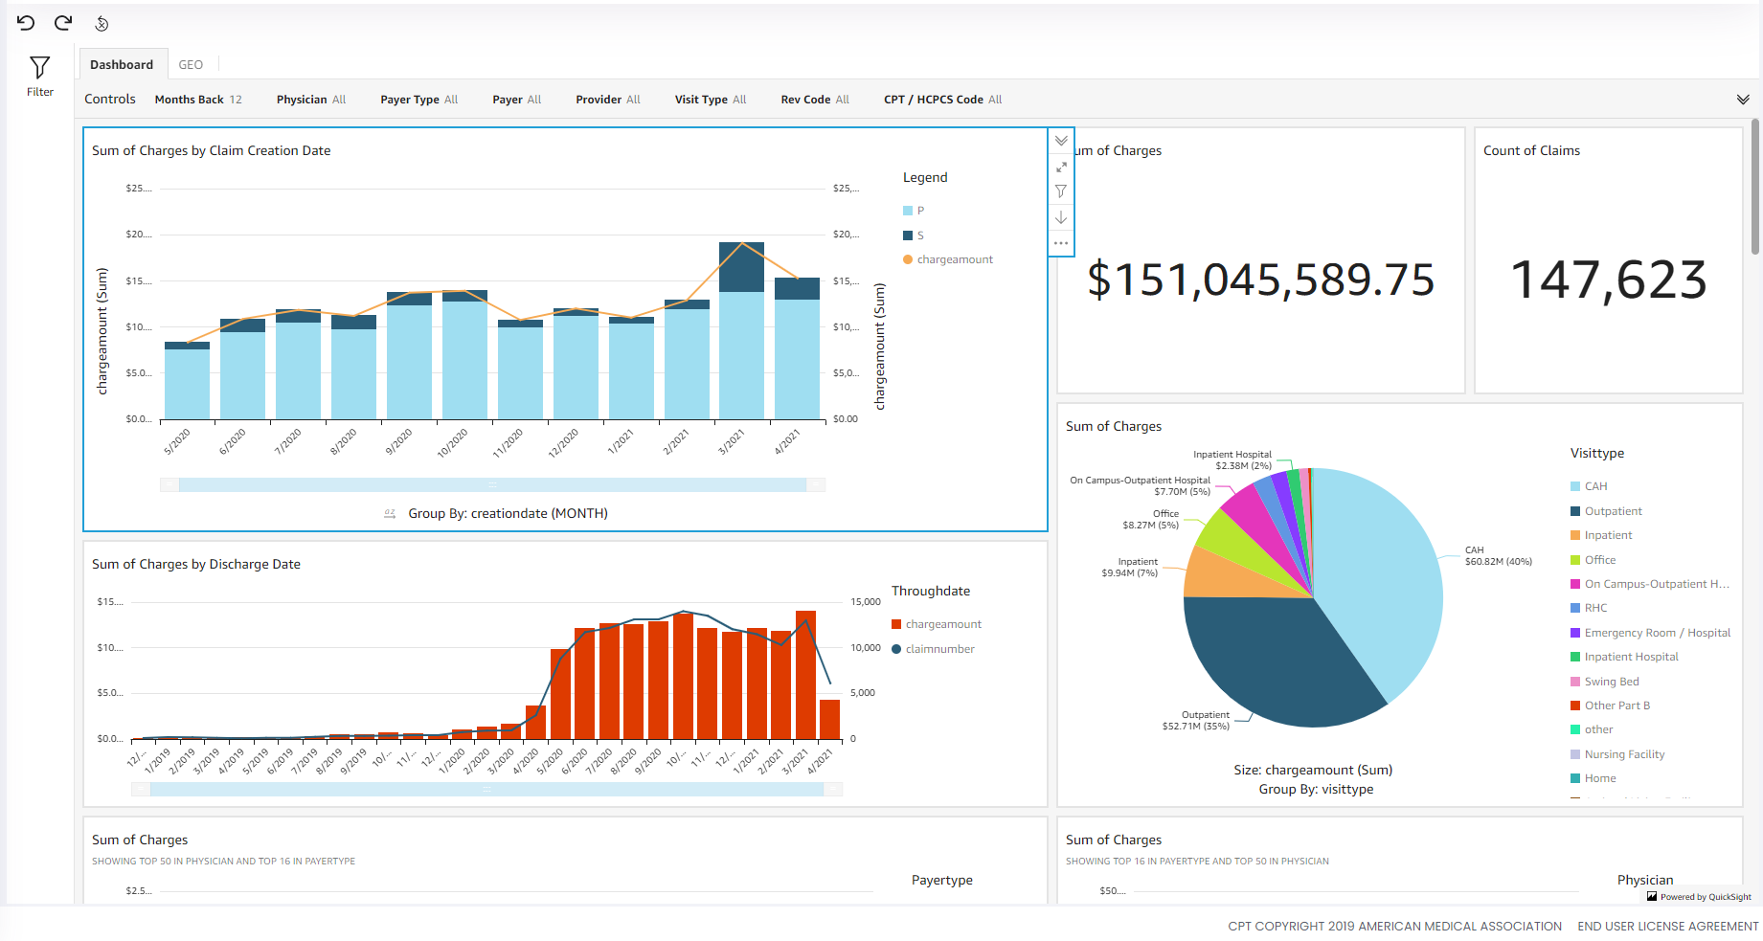
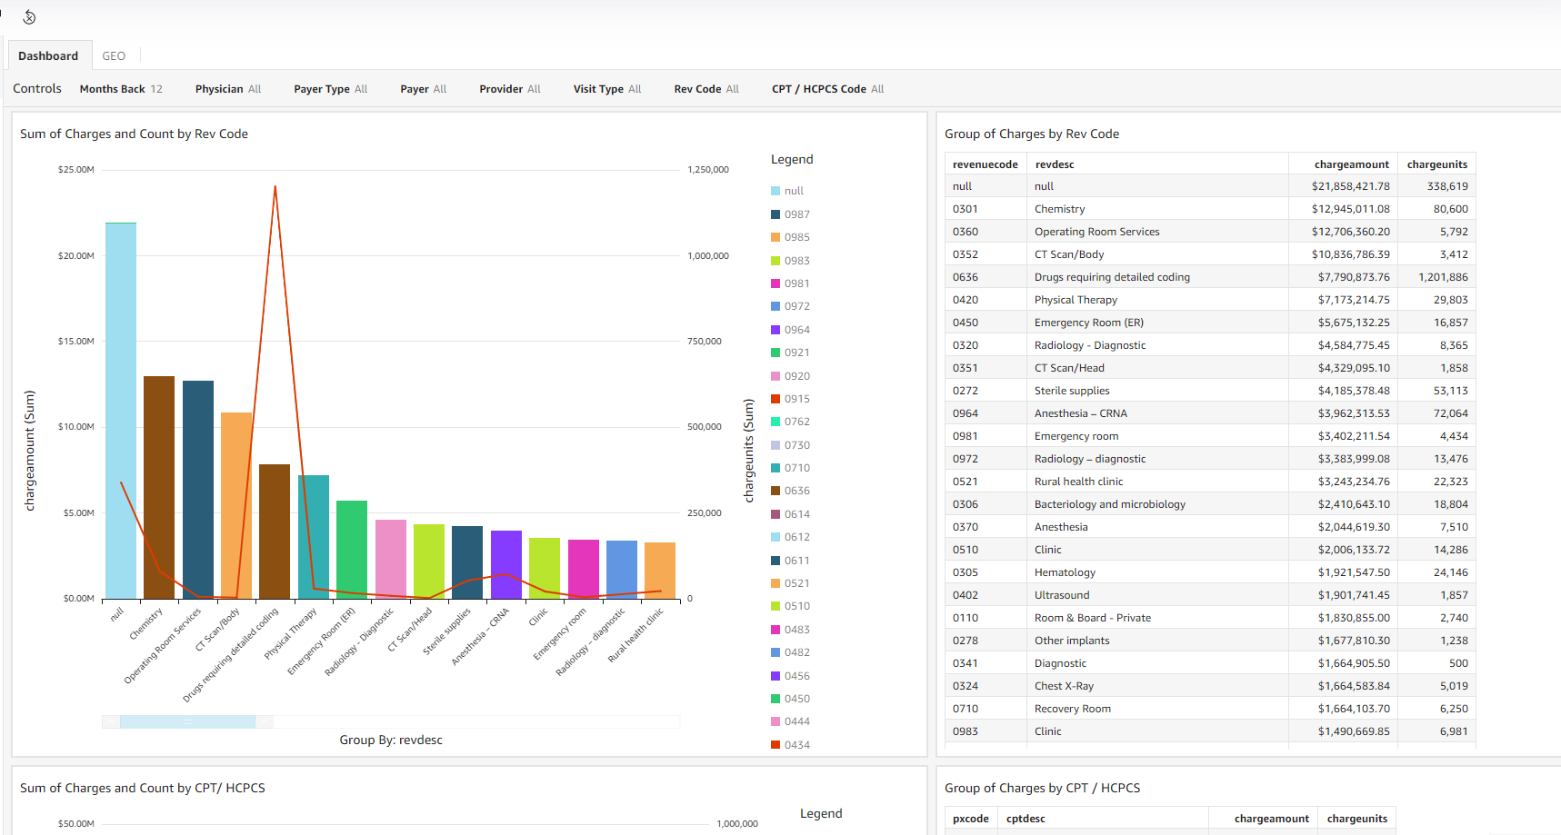
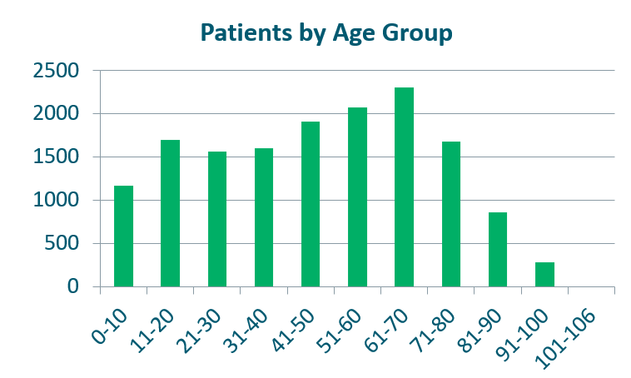
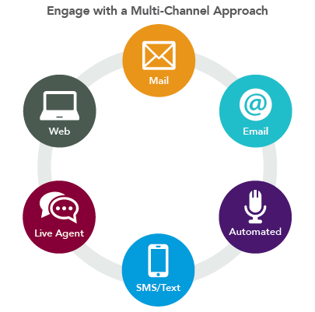
Activities
COMPdata training
Determine what is already being done
Within marketing scope
Throughout our organization
Project management & IS involvement
Benchmarking
SHSMD (Nevada)
ICAHN
Carle
CRM customer
All the demos!

Slide 7
Activities

Slide 8
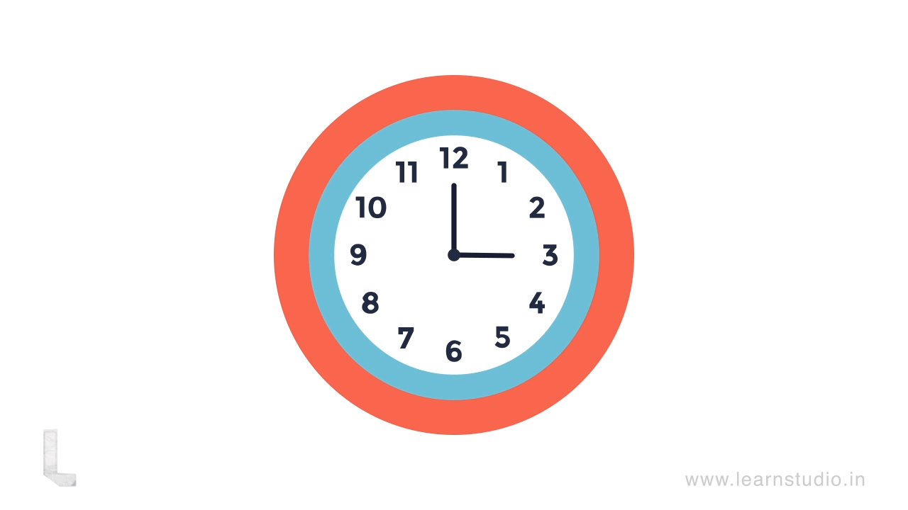
Obstacles
Timeline
Integration models
Healthcare specificity
My time
Role development

Slide 9
Outcomes
Engagement throughout
COMPdata trained; bariatric service line assessment
CRM selected!
Supplemental data
Assumptions to identify prospective patients
Outreach specialist
Data is elusive, but making progress

Slide 10
Next Steps
Implementation/pre-load tool
Pulling more data from COMPdata
Add in metrics we already have access to
Website
Online marketing metrics
Determining when to look at what
Frequency
Top 5; bottom 5
Continue training
Provider dashboards
CRM

