Slide 1
Get With The Guidelines® – Stroke
Illinois Critical Access Hospital Network
Renee M. Sednew, MPH
American Heart Association
October 22, 2018

Slide 2
Overview/Goals
Navigate Get With The Guidelines – Stroke®: Patient Management Tool, Coding Instructions, Reports
Idea for new quality improvement project at your hospital
Sample Stroke Resources
Network/connect with other hospital
Login to Get With The Guidelines® during this call

Slide 3
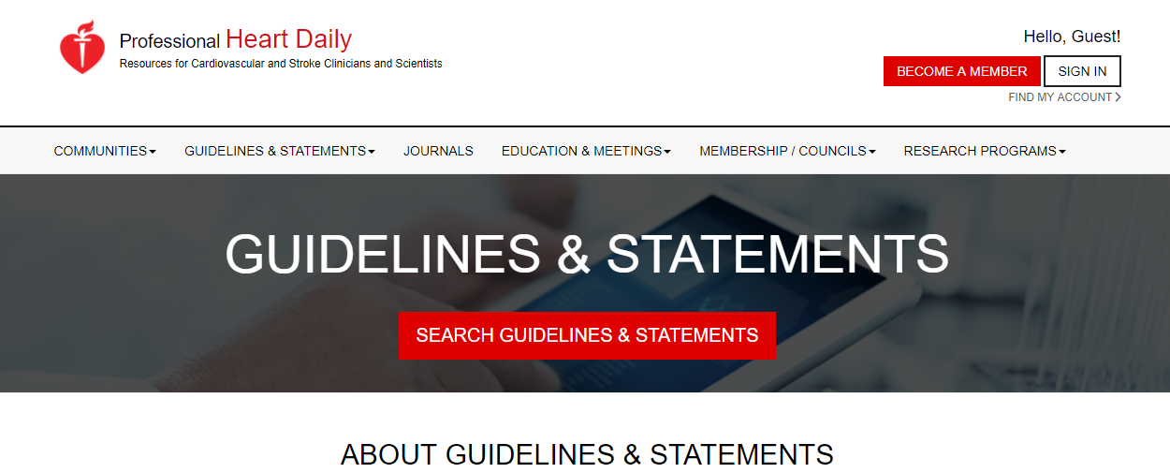
Stroke Guidelines
professional.heart.org

Slide 4
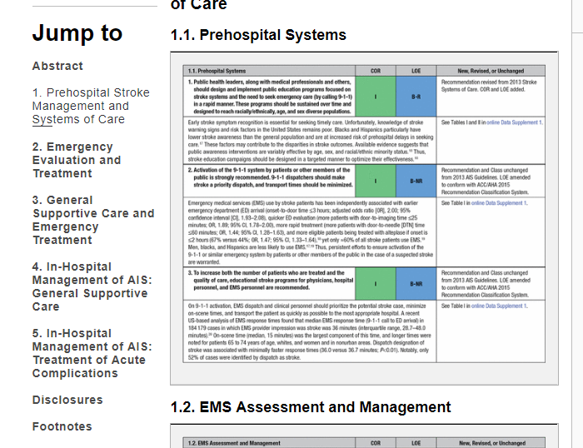
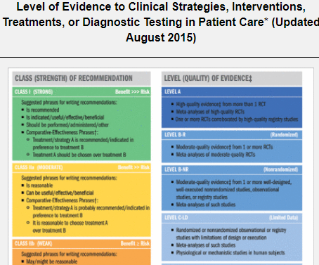

Slide 5
Get With The Guidelines® (GWTG)
Systems of Care
Hospital Performance Improvement
Trend Reports
Benchmark Data – ICAHN, state, national
Data collection for IDPH Acute Stroke Ready Hospital designation
Time Tracker Report

Slide 6
Get With The Guidelines-Stroke in IL
Approximately 80% of all ischemic stroke discharges in Illinois come from hospitals enrolled in Get With The Guidelines® – Stroke
115 Participating Illinois Hospitals
33 ICAHN Hospitals

Slide 7
Get With The Guidelines – Stroke Illinois Benchmark Groups
Hospital systems benchmarks
EMS regional benchmark groups
Midwest Stroke Action Alliance Benchmark Group
Illinois Critical Access Hospital Network Benchmark & Super User Group
Chicago Benchmark & Super User Group

Slide 8
Key Contacts
Get With The Guidelines questions – Renee Sednew
renee.sednew@heart.org
312-476-6661
GWTG Technical & Account Issues = IQVIA Help Desk
(888) 526-6700
InfosarioOutcomeSupport@quintiles.com

Slide 9
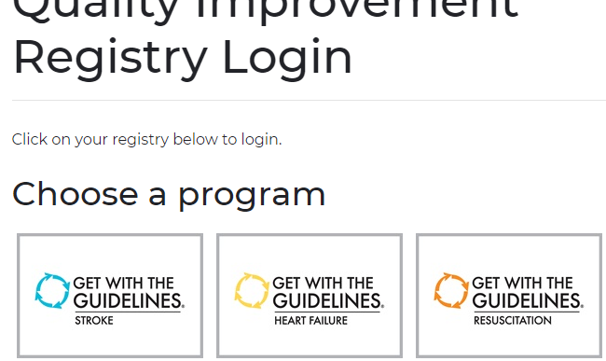
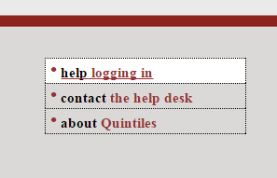
Login
www.heart.org/qualityregistrylogin
Forgot username or password
Training – available with IQVIA and Renee
Adding new users – Contact Renee

Slide 10
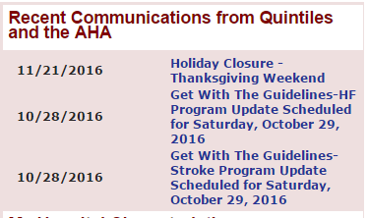
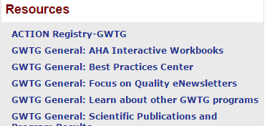
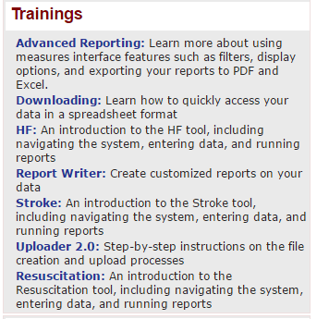
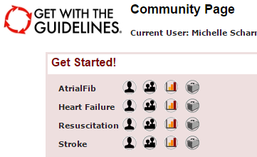
Community Page Highlights
New patient
Resources
Reports
Patient grid

Slide 11
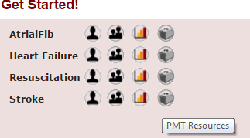
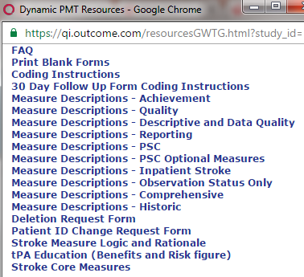
Patient Management Tool (PMT) Resources
Detailed descriptions of measures

Slide 12
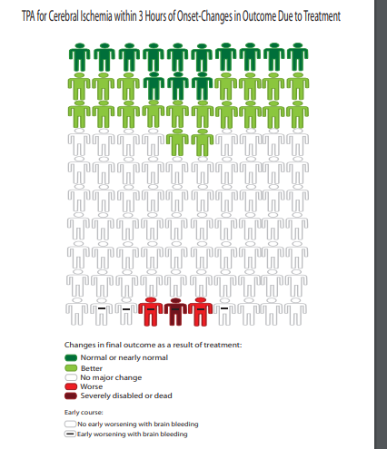

Slide 13
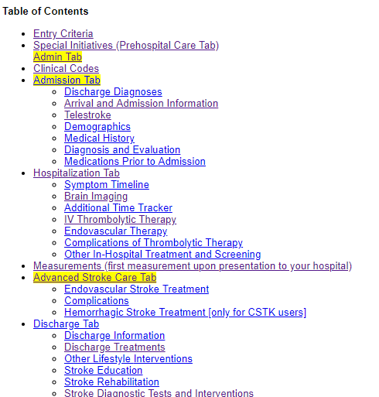
Coding Instructions

Slide 14
Entry criteria
Patients with a final/discharge diagnosis of stroke or transient ischemic attack can be included into the GWTG-Stroke® Registry. This includes cases with a principal/primary or secondary diagnosis of:
Cerebral Infarction
Intracerebral Hemorrhage (non-traumatic)
Ischemic Stroke
Stroke
Subarachnoid Hemorrhage (non-traumatic)
Transient Ischemic Attack (TIA)
Following is a list of the ICD-9-CM and ICD-10-CM codes commonly used to describe these diagnoses. For discharges prior to October 1, 2015 ICD-9-CM diagnosis codes are used for reporting diagnosis and ICD-10-CM codes for discharges on or after October 1, 2015.
SEE TABLES IN CODING INSTRUCTIONS

Slide 15
Optional and Excluded
Optional:
Patients who have an in-hospital stroke. Please note in-hospital strokes are excluded from all Achievement Measures, but are included in the GWTG Inpatient stroke measures.
Patients who present with stroke-like symptoms but who do not end up being diagnosed with a stroke or TIA (stroke mimics).
Patients evaluated, treated, and discharged from the ED (with no inpatient admission) to home or another location that is not an acute care hospital.
Patients discharged from observation status with no inpatient admission.
Patients admitted for the sole purpose of the performance of elective carotid endarterectomy or any revascularization. This type of patient would typically be excluded from GWTG-Stroke. Only enter this type of patient if needed to comply with TJC (or other) sampling plan or data entry requirements.
Exclude:
Patients < 18 years of age.

Slide 16
Notes and Abstraction Guidelines
Abstraction Guidelines:
Do not enter any personal health information/protected health information (PHI) in any free text "Comments" fields or Optional Fields 1-10, 11, & 12.
Make use of the Suggested Sources for Abstraction as a guide to help find medical documentation for each data element. Only abstract data which is clearly documented in the medical records. When in doubt, consult with your local Stroke champion or Stroke team leader for clarification.
When there is a discrepancy in documentation status or a patient's specific variable, refer to the source of medical higher authority relevant to that variable
General notation:
ND = Not Documented. Select ND when there is no documentation in the medical record to explain why a treatment or intervention is not performed.
NC = None-Contraindicated. Select NC when a reason for non-treatment was documented in the medical record (e.g. not indicated, contraindicated, patient/family refused).
UTD = Unable to determine.
TJC = The Joint Commission
PSC = Primary Stroke Center
IV t-PA (or IV rt-PA) = Intravenous Tissue Plasminogen Activator
PMT = Patient Management Tool

Slide 17
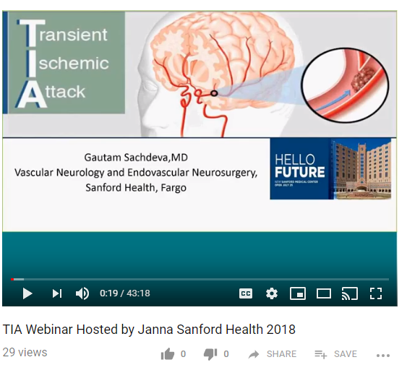
FAQs
TIAs
No Stroke Related Diagnosis
Minimum # of Cases
Minimum # of Data Elements
Data Submission
TIA webinar: https://www.youtube.com/watch?v=LI65moumgjQ

Slide 18
Navigation
1.) Patient ID
2.) Save

Slide 19
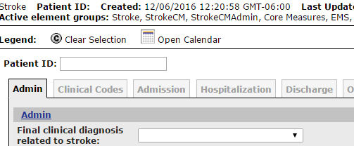
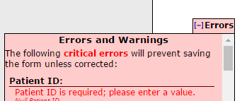
Entering Patients – Tips
Types of "Errors"
Critical Errors - prevent from saving
Errors -- prevent from saving as complete
Warnings -- informational, does not prevent from saving as complete

Slide 20
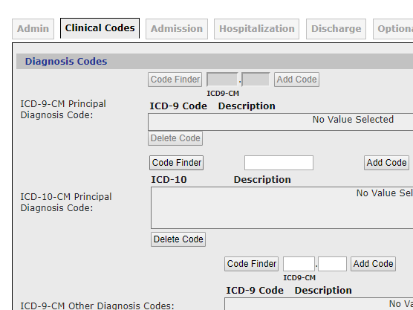
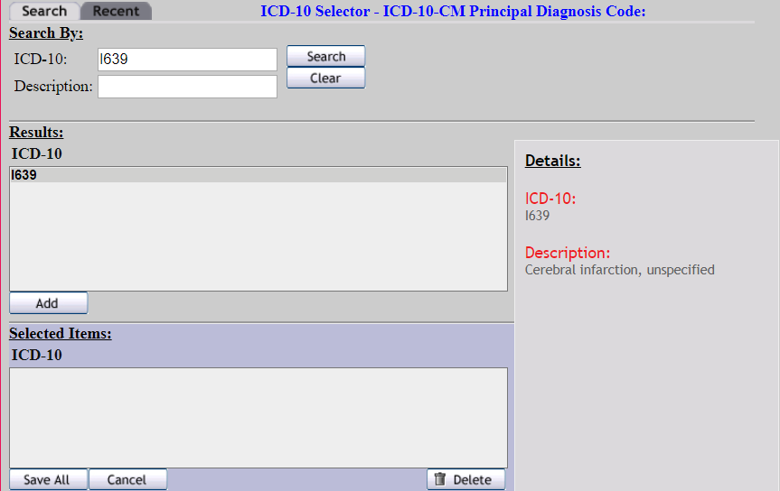

Slide 21
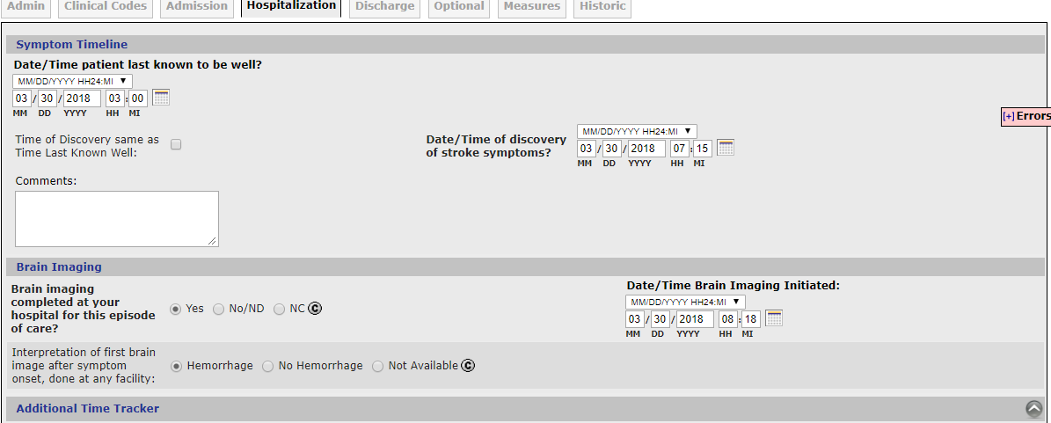
Hospitalization Tab

Slide 22
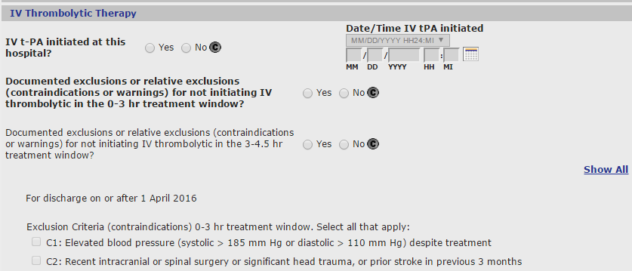
Hospitalization Tab

Slide 23
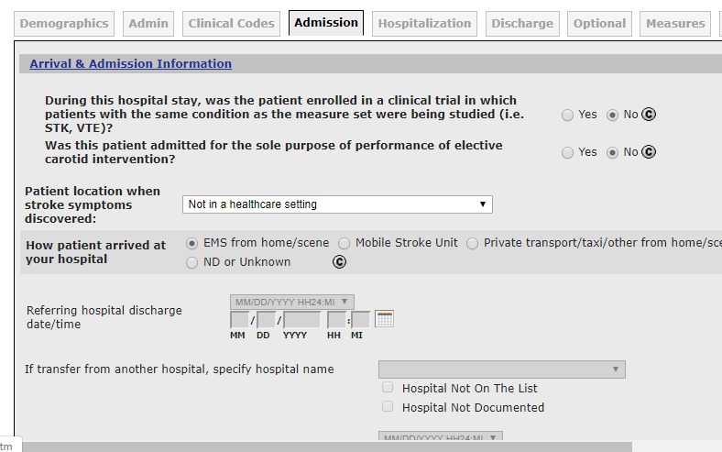
Admission Tab

Slide 24
Did you know…
Optional Fields
Transfer Data
Telestroke
Pre-Hospital Metrics
Time Tracker Report
Data Download

Slide 25
Optional Tab

Slide 26
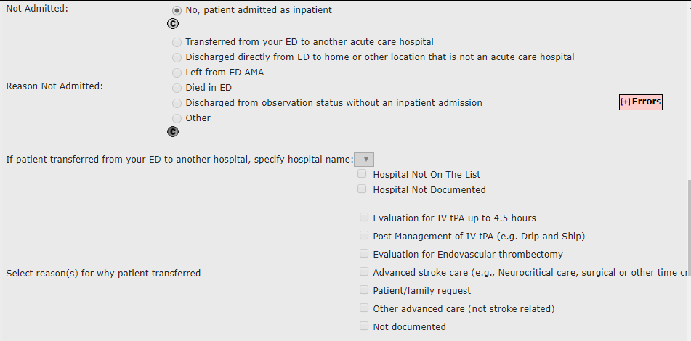
Transfer TO hospital name and reason for transfer (Admin tab)

Slide 27
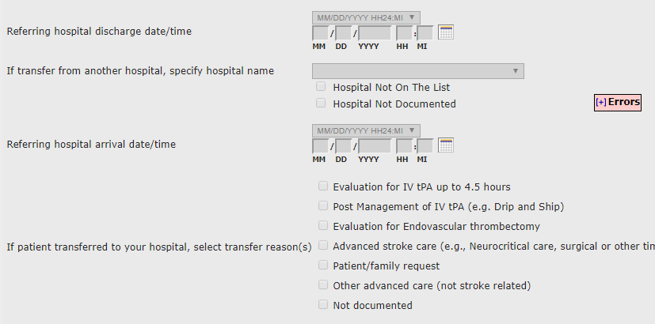
Transfer FROM hospital name and reason for transfer (Admission Tab)

Slide 28
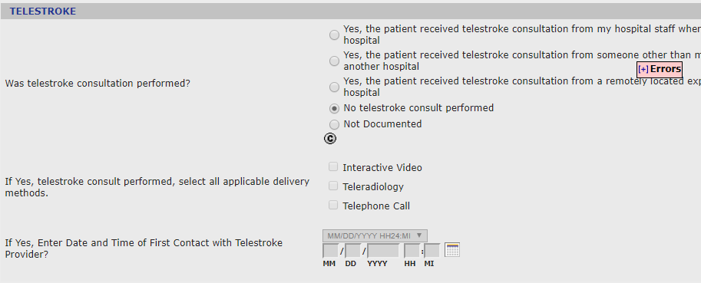
Telestroke Data Elements

Slide 29
How to Enable Telestroke Elements:
1. Login to GWTG – Stroke module
2. On the Community page, select the Update Stroke Site Characteristic hyperlink
3. On the organization form, scroll to the bottom of the page to “Settings”
4. Select “Enabled” for “Telestroke Consultation” (select “Disabled” to turn off)
5. Ability to indicate at site level if primarily a provider or recipient of telestroke consultation:
- Select “Provider of telestroke consultation” if you’re a referral center that provides telestroke services and happen to cover some of your own ED shift with your own telestroke providers.
- Select “Recipient of telestroke consultation” if you primarily receive telestroke consultation for your front-door patients and tend to transfer patients somewhere else.

Slide 30
Special Initiatives Tab: Pre-Hospital
Pre-Hospital Data Elements, such as:
EMS agency name or number
Run/Sequence Number
Date/Time Call received by EMS agency
Blood Glucose level )mg/dL)
Pre-hospital stroke screen performed – Yes/No/Not documented
Etc.
Instructions to Enable: Contact IQVIA Help Desk to request “Special Initiatives Tab” (888) 526-6700 or InfosarioOutcomeSupport@quintiles.com
Once Enabled, accessible from Patient Management Tool:

Slide 31
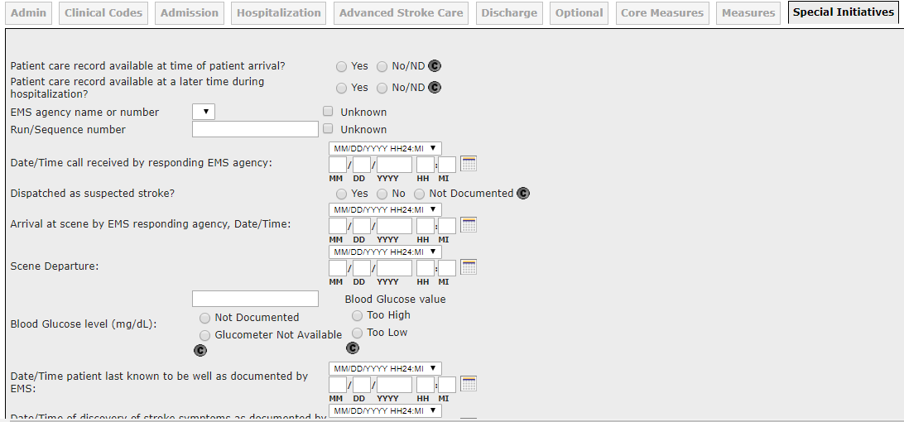
Special Initiatives: Pre-Hospital Screenshot*
*NOTE: Partial screen shot

Slide 32
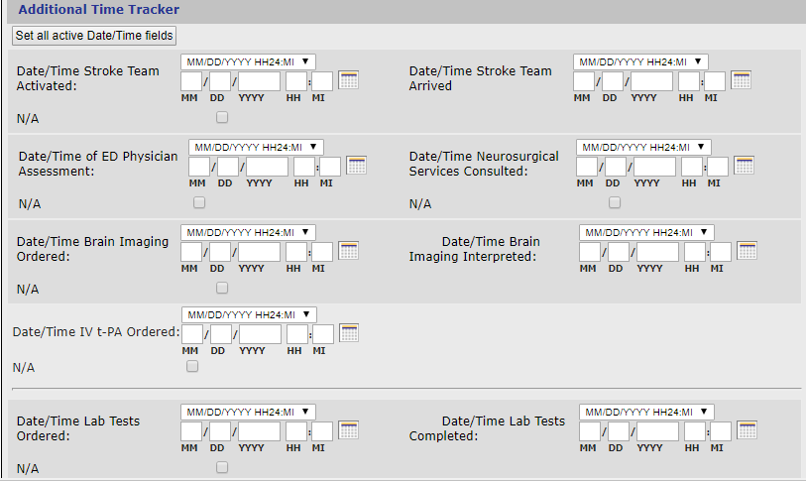
Additional Time Tracker

Slide 33
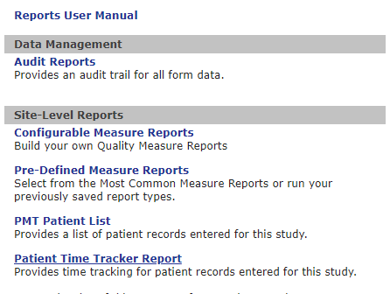
Patient Time Tracker Report

Slide 34
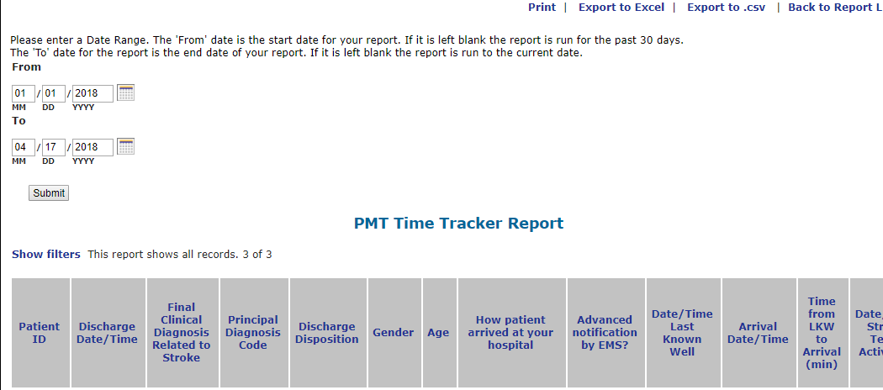
Patient Time Tracker Report

Slide 35
Data Download
Download any/all data elements for selected time period

Slide 36
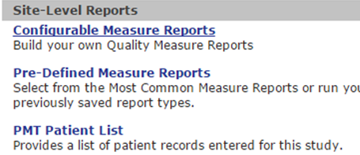
Reports
Full list of real –time reports
Save specifications for commonly run reports
Patient Grid

Slide 37
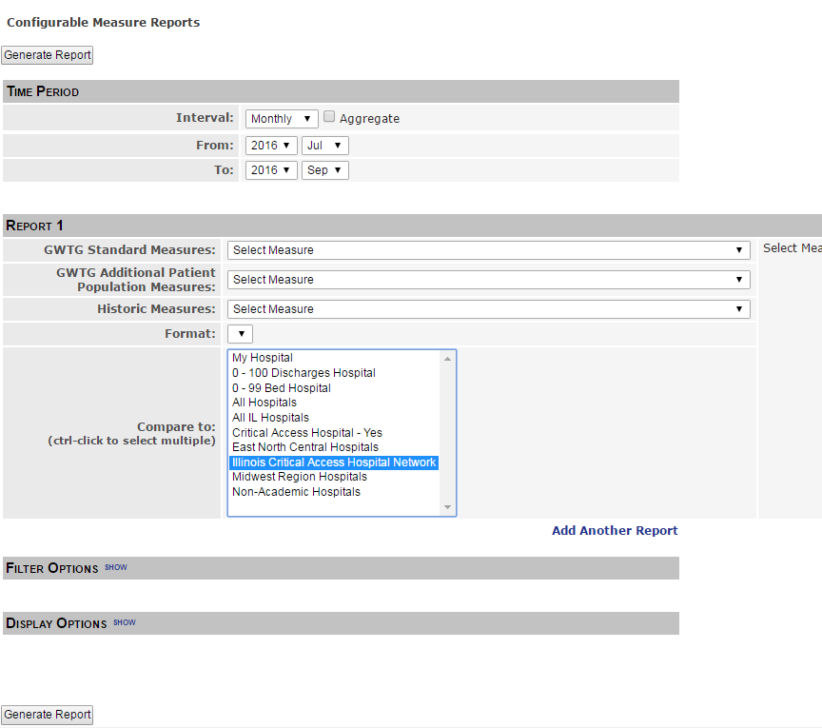

Slide 38
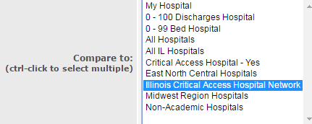
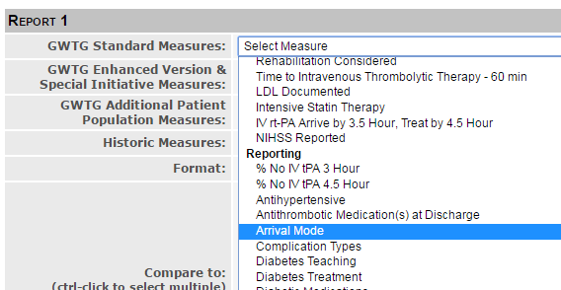
Configurable Measure Reports Arrival Mode
4
1
2
5
3

Slide 39
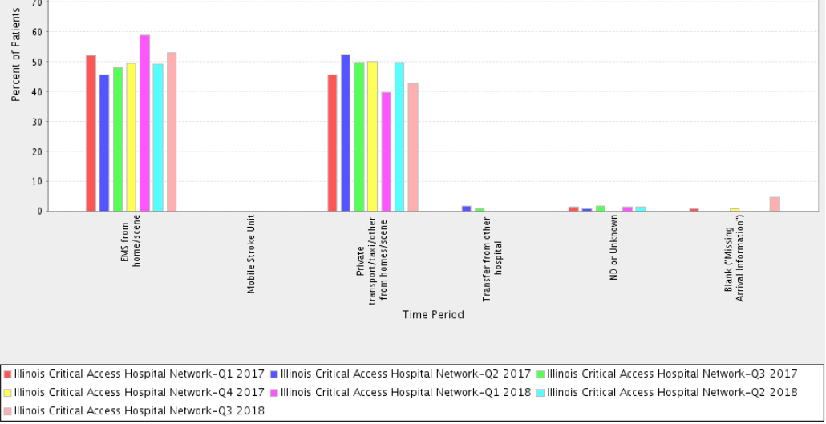
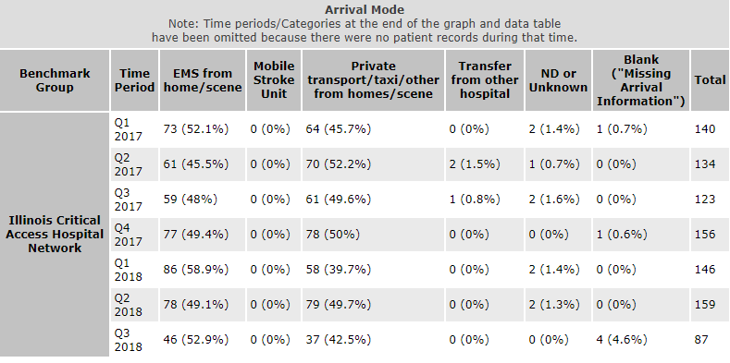
ICAHN Arrival Mode

Slide 40
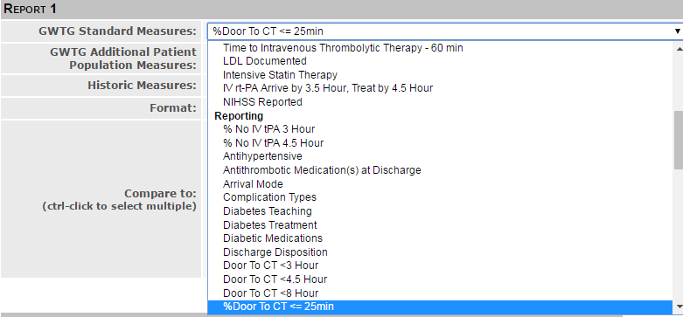
Configurable Measure Reports % Door to CT < 25 minutes
4
1
2
5
3

Slide 41
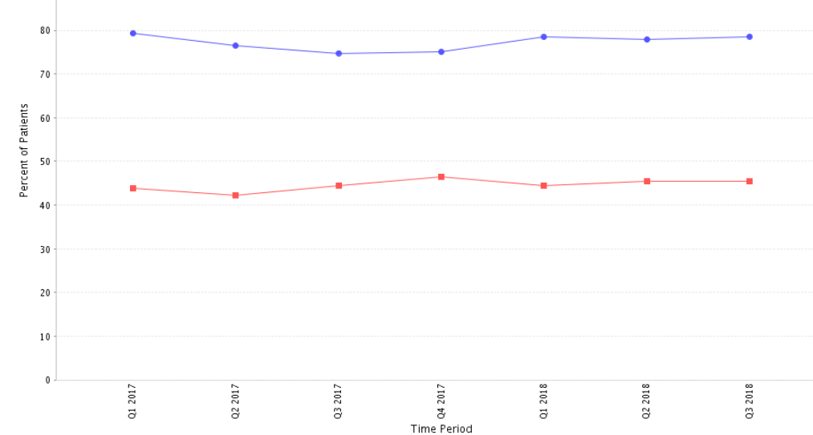
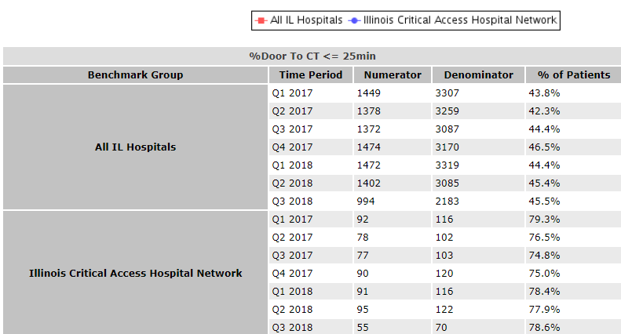
ICAHN % Door to CT < 25 minutes

Slide 42
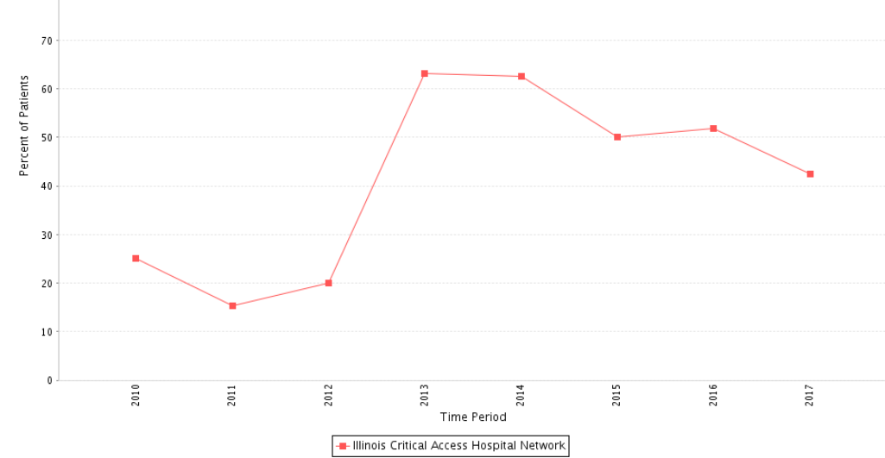
Door to Needle < 60 minutes - ICAHN

Slide 43
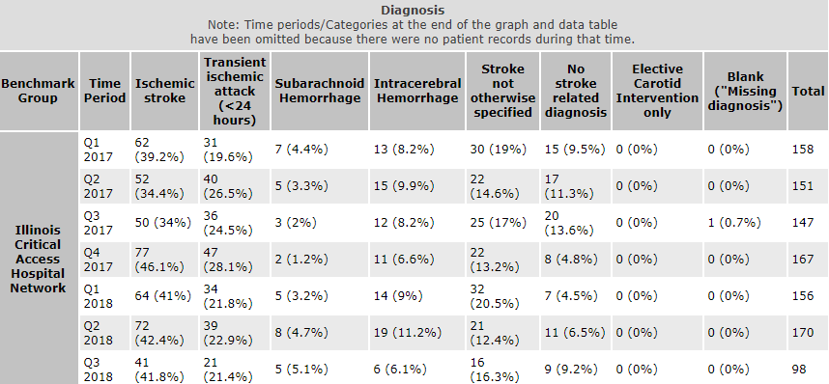
Patients grouped by diagnosis

Slide 44
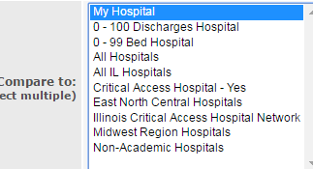
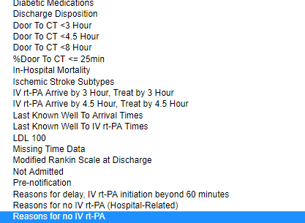
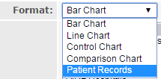
Drill down to individual cases
4
1
2
5
3

Slide 46
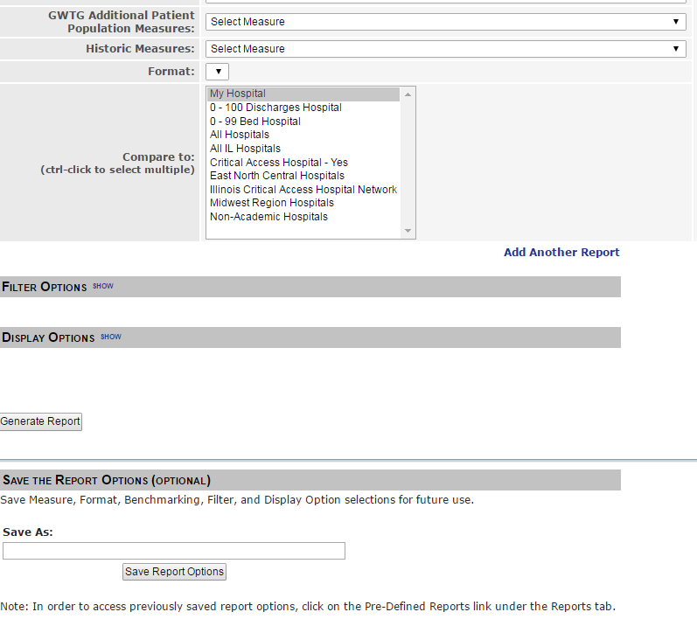
Save Report Options

Slide 47
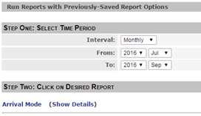
Saving Report Options
1.) Scroll to bottom of “Configurable Measure Reports:
3.) Select time period and click on report:
2.) Click on Reports Tab:

Slide 48
Dissemination

Slide 49
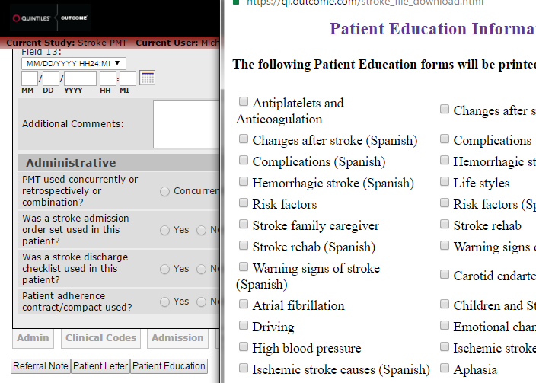
Patient Education – Resources

Slide 50
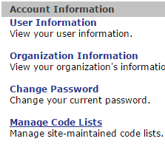
My Account

Slide 51
State Stroke Sub-Committee Updates
Designated Stroke Centers (as of 8/8/18): 79 ASRH, 63 PSC, 14 CSC
State Stroke Registry Fund (as of 8/8/18): $125,878.65
Next meeting: Wednesday, Nov 14th 11am -3pm, Normal, IL
11 EMS Regional Stroke Advisory Sub-Committees
IDPH Stroke Program website: http://www.dph.illinois.gov/topics-services/emergency-preparedness-response/ems/stroke-program#publications-publications
Current listing of state designated stroke centers
Designation applications

Slide 52
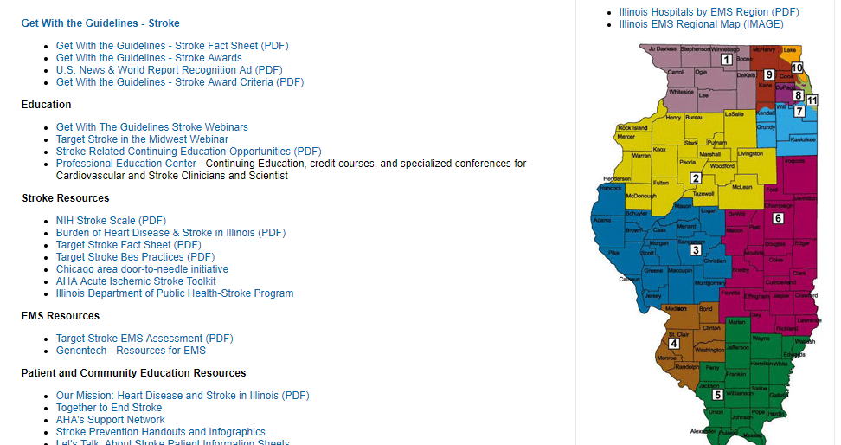
Illinois Stroke Systems of Care - Website
www.heart.org/ilstrokesystemsofcare

Slide 53
American Heart Association – Stroke Resources
www.heart.org/targetstroke - Best practices for reducing door-to-needle times
www.heart.org/quests - Chicago door-to-needle initiative
www.heart.org/quality - AHA quality programs
www.heart.org/ilstrokesystemsofcare – Illinois stroke legislative updates, clinical educational handouts and webinars, stroke related articles, EMS resources, patient and community resources
www.strokeassociation.org/AISTOOLKIT - Acute Ischemic Stroke Toolkit
www.strokeassociation.org/CS - Cryptogenic Stroke materials
strokeassociation.org/recovery – Stroke recovery and rehabilitation

Slide 54
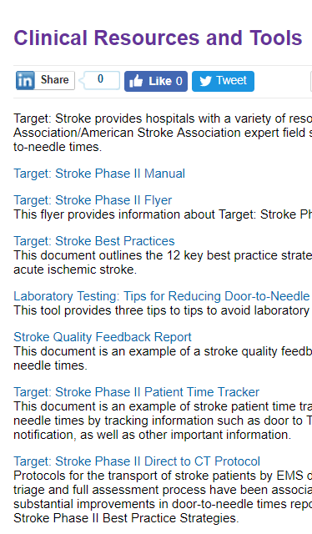
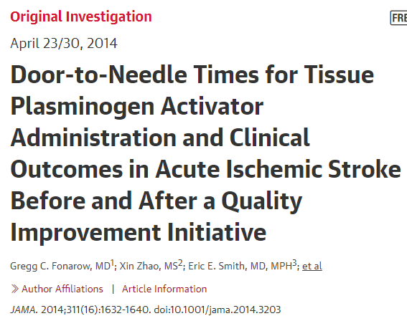
Target Stroke Resources
Patient time-trackers
Guideline based algorithms
tPA checklist
Standardized order sets
Dosing charts
Clinical pathways
Evidence-based protocols
EMS tools
Patient educational materials
Target: Stroke tools: www.targetstroke.org
Clinical tools library: heart.org/strokeclinicaltools.

Slide 55
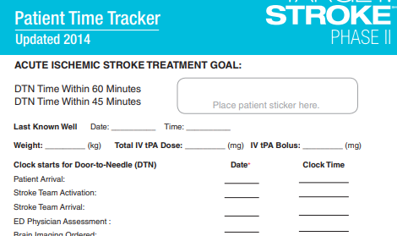

Slide 56
Professional and Patient Toolkits

Slide 57
Acute Ischemic Stroke Toolkit

Slide 58
Case Studies

Slide 59
Community and Patient Resources
Patient Information Sheets
Caregiver Guide to Stroke
High blood pressure infographic
AHA's Target BP initiative
AHA’s Support Network
Get With The Guidelines – Patient Education Materials
Stroke Prevention Handouts and Infographics
F.A.S.T. resources
Treat Stroke F.A.S.T. video

Slide 60
Questions?
Thank you!
Renée M. Sednew
312-476-6661
renee.sednew@heart.org

